Slide 1
Seeking Help for Ourselves and Others
NYC Health + Hospitals Continuing Professional Education is recognized by the New York State Education Department’s State Board for Social Work as an approved provider of continuing education for licensed social workers and accredited by The Medical Society of the State of New York (MSSNY) to provide continuing medical education for physicians. NYC Health + Hospitals designate this Live Webinar training for a maximum of 1 contact hour for social workers and 1 AMA PRA Category 1 Credit(s)™.

Slide 2
Grounding Exercise
Box Breathing 4x4
Sit down in a comfortable place
Inhale for 4 seconds through your nose
Hold your breath for 4 seconds
Exhale through your mouth for 4 seconds
Repeat for 4 times as a set or as many sets as possible
Can be done with limited breathing capacity, for a shorter duration
The planners and faculty participants do not have any financial arrangements or affiliations with any commercial entities whose products, research or services may be discussed in these materials.
Notes:
Take audience through the exercise
Mention that this can be hard to do at first
And mention that this exercise can be done in 2X2 if breathing difficulties exist

Slide 3
Agenda
Impact of COVID-19
What Is Trauma?
When Is Time to Seek Help?
Obstacles to Getting Help
Tools and Resources

Slide 4
Call to Action
“Our frontline heroes are fighting a war on two fronts. They have been through so much to protect their fellow New Yorkers, and we will not allow them to shoulder the mental toll of this pandemic alone. To those who are struggling: your city hears you, we see you, and help is on the way.”
Mayor Bill de Blasio
"As they continue caring for New Yorkers, we must care for them and their well-being. Their service goes beyond anything we could have asked for, and their mental health needs should not be overlooked.“
First Lady Chirlane McCray
Notes:
Call to Action: We need to make sure we are taking care of ourselves first in order to be able to care for others and their families. LET’S BEGIN!

Slide 5
Learning Objectives
Define trauma
Identify typical responses to trauma
Realize when “I need to seek help?”
Identify obstacles to seeking help
Consider how to self assess
How to address obstacles
Review resources to receive help

Slide 6

Impact of COVID-19

Slide 7

COVID-19 and Its Impact
Late
People & Communities
Early
Family/Social Networks
Individual:
Frontline Workers
Notes:
The COVID-19 health crisis had Acute impact as well as Long Term impact on many lives.
The individuals: the frontline workers
Families, and Social networks were impacted by this crisis
And people in the communities
This is a call to action: We need to make sure we are taking care of ourselves first in order to be able to care for others and their families LET’S BEGIN! Lets explore the mental health impact, the typical reactions people have to stress and talk about getting help

Slide 8
The Early and Late Impacts of Trauma
Early Impact
Late Impact
Some people may experience more severe stress reactions after an exposure to trauma and may need help coping (family and friends)
Some people are at a higher risk for developing exposure related to health and mental health disorders and are likely to need professional help to recover
Source: NYC Department of Health & Mental Hygiene
Notes:
Some reactions cause an impact to your life immediately while sometimes there is a delay and the impact happens later. Sometimes the impact is not too severe, and you can recover on your own with a little help from family and friends. Some reactions to stress and trauma are more serious and will require help from a professional to recover.

Slide 9
The Mental Health Impact
The COVID-19 health crisis resulted in many frontline workers facing conditions that put them at risk.
Frontline workers continued to work with NYC residents impacted by COVID-19, directly and indirectly, even though they were personally impacted
They often had limited time to take care of their own physical, emotional, spiritual, and mental well-being and are not seeking HELP.

Slide 10

What Is Trauma?

Slide 11
Trauma Has Been Defined in Many Ways. It is…
A combined negative impact of stress
A response to a deeply distressing or disturbing event that overwhelms an individual’s ability to cope
An episode that causes feelings of helplessness and hopelessness.
An experience that diminishes one’s sense of self and the ability to feel a full range of emotions
A situation where your well-being or life is in danger and can result in a prolonged experience with high levels of stress
Notes:
Important Notes
Not everyone experiences trauma in the same way
Some individuals recover quickly while others might be “stuck”
Certain situations get the best of us and we may need more guidance to get “unstuck”
The feeling of “I can’t take care of myself” can be jarring for frontline workers
Discussion Point: What are your Thoughts and Feelings about Trauma?

Slide 12

Typical Reactions to Trauma
Cognitive
Emotional
Behavioral
Physical
Spiritual
Why yes, I am feeling a bit stressed.
Why do you ask?
Source: The NYC Department of Health & Mental Hygiene

Slide 13

Cognitive Reactions
Confusion
Difficulty identifying familiar objects
Trouble concentrating
Difficulty making decisions
Elevated/impaired alertness
Flashbacks/intrusive images
Memory problems
Source: The NYC Department of Health & Mental Hygiene

Slide 14

Emotional Reactions
Shock
Disbelief
Denial
Loneliness
Sorrow
Numbness
Fear
Agitation
Anxiety
Irritability
Anger
Grief
Guilt
Source: The NYC Department of Health & Mental Hygiene

Slide 15

Behavioral Reactions
Not acting “like you”
Having emotional outbursts
Argumentativeness
Hyperactivity or withdrawal
Suspiciousness
Restlessness
Changes in appetite
Changes in sleep patterns
Smoking or using drugs and alcohol
Source: The NYC Department of Health & Mental Hygiene

Slide 16

Physical Reactions
Exhaustion
Headache
Dizziness
Weakness
Nausea
Sweating
Chills
Rapid heart rate
Chest pains
Difficulty breathing
Nonspecific body complaints
Source: The NYC Department of Health & Mental Hygiene

Slide 17

Spiritual Reactions
Cynicism
Feelings of emptiness
Loss of meaning and purpose
Questioning one’s basic beliefs
Questioning basic values, withdrawal from or sudden turn towards spirituality
Alienation and loss of sense of connection
Source: The NYC Department of Health & Mental Hygiene

Slide 18
Typical Reactions to Trauma
Most people exposed to stressful and traumatic events will show some signs of stress
There is no right or wrong way to react
Everyone experiences stress in their own way
Source: The NYC Department of Health & Mental Hygiene

Slide 19
Typical Reactions to Trauma
  Freeze
  Fight
  Flight
  Appease
Source: ”Response to Threat: Freeze, Appease, Flight, Fight,” Psychology Tools Limited. 2020
Notes:
FREEZE-FIGHT-FLIGHT-APPEASE
Our bodies/minds are adapted to respond automatically to threatening events
Freeze: If you feel anxiety or desperation when afraid, you’ll likely freeze. Stopping all movement (mental or physical) until a problem goes away. Can feel paralyzed with decisions/actions.
Fight: If you feel anger or frustration when afraid, your likely response will be fight. It is our body’s response to defend itself.
Flight: If you feel terror or alarm when afraid, you’ll probably respond by flight. Run away from our problems (Ignoring them or through substances)
Appease: If you feel dismay or foreboding, you’ll try to appease. Take the blame yourself when in an anxious situation.

Slide 20
Reactions to Trauma
Brief, normal reactions to an abnormal situation
Not a psychiatric disorder
Temporarily affects health
May appear immediately, weeks, months, or even years after the event
Most people will recover on their own
Source: The NYC Department of Health & Mental Hygiene

Slide 21

When Is It Time to Seek Help?

Slide 22
When Is It Time to Seek Help?
Persistent trouble falling asleep or staying asleep
Changes in mood including irritability, vigilance, numbness, or anger
Using substances like alcohol more frequently or in higher amounts than usual, feeling like you need it to relax or sleep
Having trouble in relationships – feeling withdrawn, disconnected
Feeling unsafe even in situations that should be ok, having trouble relaxing
Notes:
When you know you need to seek help, take into consideration that your mind and body may be trying to tell you to pay attention to these common response to stress and trauma

Slide 23
Pulse Checks
Notes:
I am realizing I may be experiencing feelings, thoughts and/or behaviors
which means to me
I may need HELP BUT
I am not too sure.
When is it time to seek HELP?

Slide 24
Different Types of Check-ins
Check-in with a Family/Friend: Connecting to an individual who knows you intimately will give you the opportunity to ask what another trusted individual sees you are experiencing.
Check-in with a PCP/Healthcare Professional: Our personal physician or a licensed professional are trained to assist you to seek HELP when assessing your needs.

Slide 25
Different Types of Check-ins
Check-in with Anonymous Hotline: There are local and national hotlines where you can find mental health professionals and peer counselors to listen and give insight into what you are experiencing.
Check-in with your Employee Assistance Programs: These programs provide education, information, counseling, and individualized referrals to assist with a wide range of personal and social problems

Slide 26

Obstacles to
Getting Help

Slide 27
What Influences Seeking Help?
Stigma
Fear
Culture
Cost
Time
Notes:
Definition
Example
A set of negative and often unfair beliefs that a society or group of people have about something
Talking to a therapist means you're "weak" or "crazy“.
A belief that something, based on reality, can negatively impact you without knowing its potential outcome
Fearing that this experience has damaged me permanently and I'll never feel better
As a HELPING individual, you may be juggling personal/professional time to take care of yourself/your needs.
“Everyday I have to go to work (9-5) and return home to help my kids with their homework.“
Medical Insurance plans may have limitations to covering long-term outpatient services which may incur unexpected financial responsibilities.
Many people struggle to understand medical insurance benefits, particularly for mental health, and worry about affording it right now
An individual’s cultural, gender-role or spiritual beliefs will influence the type of help to seek
My role as the breadwinner may be questioned if I see a counselor.

Slide 28
What Does Help Look Like?
Self-Care Suggestions
Two (2) minute gratitude routine
Exercise daily or every other day
Communicate with others via video platforms
Call a friend or family
Journal your daily experiences
Listen to calming music
Meditate in a quiet space
Connect to healthy social networks
Practice your breathing exercises
Notes:
Discussion Point: Ask the participants to share tips, ideas, and positive experiences

Slide 29
What Does Help Look Like?
Seek professional help when:
After a crisis, normal stress reactions:
  Worsen
  Last for an extended period of time
  Interfere with daily functioning
After a crisis, signs and symptoms of trauma caused mental illnesses appear (e.g., PTSD, depression, generalized anxiety disorder, substance use)
After a crisis, pre-existing mental health conditions or illnesses worsen

Slide 30

Tools & Resources

Slide 31
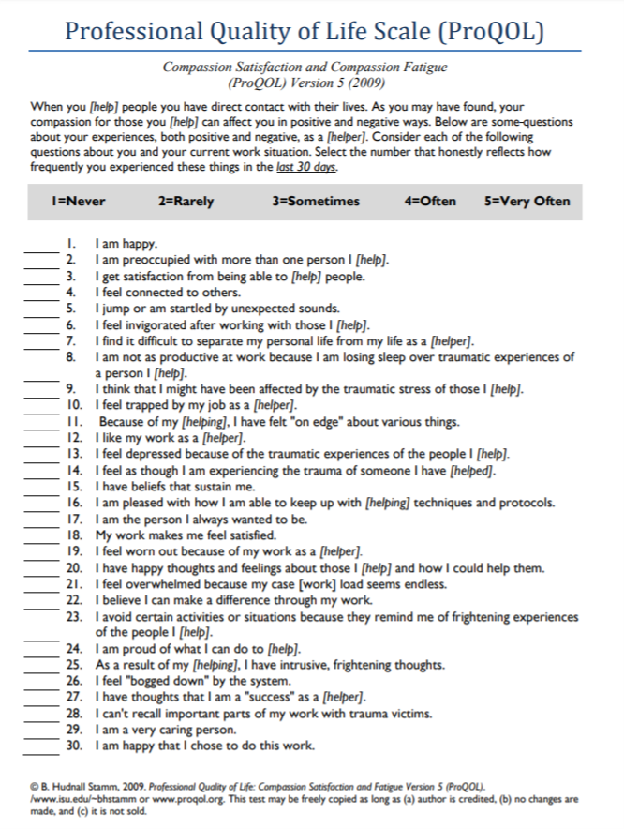
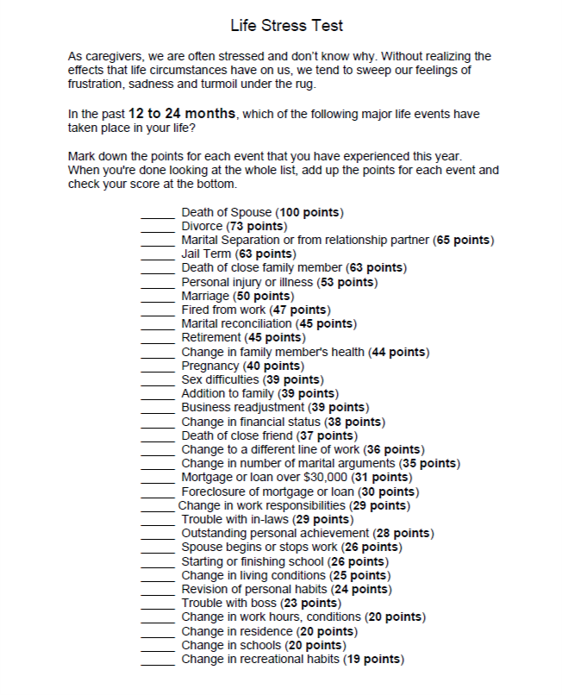
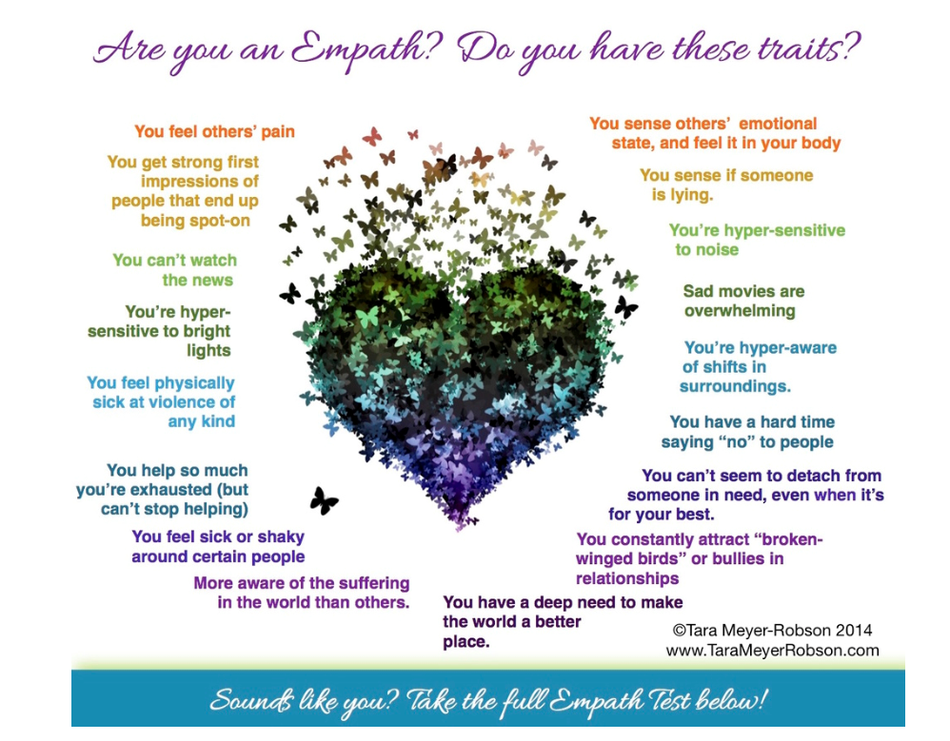
Source: B. Hudnall Stamm, 2009. Professional Quality of Life: Compassion Satisfaction and Fatigue Version 5 (ProQOL). www.isu.edu/~bhstamm or www.proqol.org
Notes:
The Professional Quality of Life Scale Tool is the most widely used measure of the positive and negative aspects of helping in the world (https://proqol.org/ProQol_Test.html)
LifeStress Test is another tools developed by Dr. Tim Lowenstein proven to be a measure of compassion satisfaction and fatigue. (https://www.compassionfatigue.org/pages/lifestress.html)
Empath Test was designed by Tara Meyer-Robson and The Flow, LLC to help you recognize symptoms of Compassion Fatigue (http://www.tarameyerrobson.com/empath-test)

Slide 32
Steps to Getting Help
Make a decision
Reach out
Follow through
Notes:
Make a Decision: Choosing the combination or selection of HELP you think matches your needs is the starting point
Reach out: Connecting to your HELP starts with a phone call or reaching out to a person/agency.
Follow Through:
Commit to taking care of yourself
Identify specific things with what you want help
Stick with the type of HELP and make it a time specific ritual
Enlist others to support your help-seeking decision

Slide 33
Personal Goal Setting
Get enough sleep
Get enough to eat
Do some light exercise
It’s OK if you’re not OK
  Expect to get through this together
  It is OK to need additional support
Vary the work that you do
Learn from your mistakes
Friendly reminder
Do something pleasurable
Pray, meditate, or relax
Focus on what you did well
Support a colleague
Share a private joke
Sources: US Department of Defense
“Caring for Yourself” clip © Eastwoods, LLC, 2020. Authors: Beth Hudnall Stamm, Craig Higson-Smith, Amy C. Hudnall and Henry E. Stamm, IV 2004-2020

Slide 34
Resilience
Optimism
Healthy
self-esteem
Spirituality
Tendency
to find meaning
Curiosity
Strong
social support
Adaptability
THINGS THAT PROTECT
Source: NYC Department of Health & Mental Hygiene
Notes:
Resilience is typically defined as the capacity to recover from difficult life events. Resilience is the psychological quality that allows some people to be knocked down by the adversities of life and come back at least as strong as before. Rather than letting difficulties, traumatic events, or failure overcome them and drain their resolve, highly resilient people find a way to change course, emotionally heal, and continue moving toward their goals. Some characteristics to strive for are: optimism, self-esteem, spirituality, adaptability, curiosity, tendency to find meaning, and strong social support. These are characteristics to help protect you in times of stress.

Slide 35
Resources Available
NYC Employee Assistance Program
Provides services to select NYC employees and their family members. Generally, an EAP provides education, information, counseling and individualized referrals to assist with a wide range of personal and social problems.
Telephone: 212-306-7660 | Website: https://www1.nyc.gov/site/olr/eap/eaphome.page
NYS OMH Emotional Support Helpline
Provides free and confidential support, helping callers experiencing increased anxiety due to the coronavirus emergency.
Telephone: 844-863-9314 | Website: https://omh.ny.gov/omhweb/covid-19-resources.html
NYC WELL Telephonic Support Services
Free, confidential mental health support for NYC residents to get access to mental health and substance use services, in more than 200 languages, 24/7/365.
Telephone: 888-692-9355 | Website: https://nycwell.cityofnewyork.us/en/
National Suicide Prevention Lifeline
The Lifeline provides 24/7, free and confidential support for people in distress, prevention and crisis resources for you or your loved ones, and best practices for professionals.
Telephone: 800-273-TALK (8255) - Press 1 if you are Veteran | Website: https://suicidepreventionlifeline.org/

Slide 36
Resources Available
Substance Abuse and Mental Health Services Administration Helpline
A free, confidential, 24/7, 365-day-a-year treatment referral and information service (in English and Spanish) for individuals and families facing mental and/or substance use disorders.
Telephone: 1-800-662-HELP (4357) | Website: https://www.samhsa.gov/find-help/national-helpline
Physician Support Line
This is a national, free, and confidential support line service made up of volunteer psychiatrists providing peer support for physician colleagues during COVID-19 epidemic.
Telephone: 1-888-409-0141 | Website: https://www.physiciansupportline.com/
NYC's 24-hour Domestic Violence Hotline
Survivors of domestic violence may receive temporary housing, emergency shelter and supportive services for themselves and their children.
Telephone: 1-800-621-4673 | Website: https://www1.nyc.gov/site/hra/help/domestic-violence-support.page
Facility Based Services (If applicable)
Pastoral Care
Staff Support Groups

Slide 37
Call to Action
Hope is the only thing to save you from despair.
C.S. Lewis
Notes:
Call to Action: We need to make sure we are taking care of ourselves first in order to be able to care for others and their families.

Slide 38
Looking Ahead
Today’s 1-hour presentation is the fourth in a series of 5
Stress, Trauma & Resiliency
Personal & Professional Wellness
Impact, Effect & Outcome on Frontline Workers
Seeking Help for Ourselves & Others
Resilience & Wellness Program Development (July 1)

Slide 39

Thank
You
Contributors to Presentation:
NYC Health + Hospitals | Office of Behavioral Health: Mr. John Cancel
NYC Health + Hospitals | Office of Quality and Safety: Mr. Jeremy Segall
NYC Health + Hospitals | Kings County: Dr. Kristen Baumann; Dr. David Tzall; Dr. Shveta Mittal; Dr. Karen Forbes
NYC Health + Hospitals | Workforce Development: Ms. Ivelesse Mendez-Justiniano; Ms. Alice Stafford
NYC Department of Health & Mental Hygiene: Dr. Monika Erős-Sarnyai
Columbia University Medical Center: Dr. Elizabeth Murphy Fitelson

Slide 40

Panel Discussion and Q&A
Please share your questions
Are there tools we did not mention that you find helpful with coping?
What additional resources would help?
Panelists
  David Shmerler, PhD, Director of Counseling Service Unit, Fire Department of New York
  David M. Benedek, MD, Professor and Chair, Psychiatry, USUHS
  Eliot Goldman, PhD, Psychologist and City Research Scientist, Mental Health Innovation, NYC Department of Health + Mental Hygiene
  Michael Fisher, MSW, Chief Officer, Readjustment Counseling Service, Veterans Health Administration

