Slide 1
Stress, Trauma & Resiliency
Tools for Use Now, Later & Long-Term
NYC Health + Hospitals Continuing Professional Education is recognized by the New York State Education Department’s State Board for Social Work as an approved provider of continuing education for licensed social workers and accredited by The Medical Society of the State of New York (MSSNY) to provide continuing medical education for physicians. NYC Health + Hospitals designate this Live Webinar training for a maximum of 1 contact hour for social workers and 1 AMA PRA Category 1 Credit(s)™.

Slide 2
Grounding Exercise
Box Breathing 4x4
Sit down in a comfortable place
Inhale for 4 seconds through your nose
Hold your breath for 4 seconds
Exhale through your mouth for 4 seconds
Hold your breath for 4 seconds
Repeat for 4 times as a set or as many sets as possible
Can be done with limited breathing capacity, for a shorter duration
The planners and faculty participants do not have any financial arrangements or affiliations with any commercial entities whose products, research or services may be discussed in these materials.
Notes:
Take audience through the exercise
Mention that this can be hard to do at first
And mention that this exercise can be done in 2X2 if breathing difficulties exist

Slide 3
Task Force Story
On April 29th, 2020, NYC Mayor Bill DeBlasio and First Lady Chirlane McCray announced a collaboration with US Department of Defense (DoD) to help frontline workers to cope with Stress.
NYC Health + Hospitals, in collaboration with multiple stakeholders, developed the Resilience and Trauma Training Series known as Healing, Education, Resilience & Opportunity for New York’s Frontline Workers (HERO-NY) to support health care workers and first responders on the front lines of the COVID-19 pandemic.
HERO-NY has tailored elements of the US DoD’s combat stress management and resilience program into a webinar training series to be used in civilian health care and first responder settings across the city.

Slide 4
Overview of Series
Today’s presentation is the first of 5
1-hour presentations with panel discussions, videos, etc.
Today is meant to be a primer:
  How does stress lead to trauma and burnout?
  What is different about the pandemic?
  How do we cope? How do we heal?
    In the moment
    In the day
    Until we are through
You will hear from your colleagues, from experts, from yourselves
  Today will include a panel discussion
Notes:
Presenters will take you deeper into:
Resilience skills
Support for grief and loss
How to know what to do and when to ask for more support
You will hear from expert clinicians, researchers, and frontline workers
The goal is to provide skills and tools for frontline workers
And start the work each agency will need to do to promote healing for frontline workers in the months and years to come

Slide 5
Learning Objectives
Gain an understanding of research on resiliency and the impact of disasters on psychological well-being in frontline workers
Develop basic skills and coping tools for immediate stress reduction in the field
Develop basic skills for use outside of frontline work
Learn how to spot check and identify the need for additional support, and learn where to access this help within NYC

Slide 6
Primer: Introduction to Resilience
When you hear the word resilience, what comes to mind?
In the current crisis, has your definition changed? Grown?
And as health care professionals, our job is often to keep it together and carry others through
  Many of us even do this for our families and friends
  Many of us are afraid of falling apart. “What if I can’t keep others afloat?”
Notes:
Presenter to explain that resilience means different things to different people. Each person experiences the current crisis differently.
Here are some phrases and descriptions others have shared, so that we can hear from others (read examples).

Slide 7
Definitions of Common Terms
Stress – sense of something is not right and something needs to change
Distress – when the overwhelm overwhelms
Disorder – when you need outside help
Burnout – when the above leads to not being able to cope at work
Compassion fatigue – when burnout leads to a loss of caring feelings for patients and loved ones
Trauma – psychological and physical overwhelm from stress
Complex trauma – cumulative trauma often over long periods of time (previous trauma + current trauma = too much trauma)
Coping mechanism/skills – tools we can use to carry ourselves through (can be positive or negative)
Resilience – a combination of support and care from outside and within, plus positive coping skills that allow us to heal after the crisis has passed
Notes:
Read aloud
Mention that this is not clinical language, but should exemplify how the average person thinks of this

Slide 8
Psychological & Behavioral Responses to Disasters
Change in Sleep
Decreased Sense of Safety
Physical (Somatic) Symptoms
Irritability, Distraction
Isolation, Avoidance
Depression
PTSD
Anxiety
Complex Grief
Alcohol, Tobacco, Rx meds
Disrupted Work/Life Balance
Interpersonal Violence
Restricted Activities/Travel
Distress Reactions
Psychiatric Disorders
Resilience
Risky Behaviors
Notes:
Additional information to share, as needed:
Following a disaster, some people will do well and promptly resume their life activities at a similar level of functioning.
Some may even experience an increase perception of their own ability to care for themselves and come to feel more capable of handling adversity in the future; this phenomena is often termed “post-traumatic growth”.
However, a sizable minority will experience one or more adverse psychological and/or behavioral responses. It is useful to consider them in terms of frequency from least to most common. For instance, when considering psychological effects of disasters, many people think of psychiatric disorders, often PTSD. Psychiatric disorders do produce considerable morbidity and mortality after disasters and it is important to understand risks for developing disorders, how to properly conduct surveillance and assessment, when to refer, and how to appropriately treat these conditions. However, it’s equally important to realize that health risk behaviors and distress reactions are experienced almost immediately and with greater frequency than psychiatric disorders following a disaster, producing the bulk of public mental health burden in the days and weeks immediately following the event.
Following disasters, distress reactions and health risk behaviors predominate. Difficulty with sleep, social isolation, increased use of alcohol and tobacco and other distress responses and health risk behaviors confer the bulk of psychological and behavioral public health burden following disasters. Consider the range of adverse impacts to a community which is largely under slept, irritable, isolative and increasingly reliant on alcohol and tobacco to manage feelings of distress. Public health effects may include increased motor vehicle and other accidents, intimate partner violence and impaired family relationships, as well as decreased work productivity. Some will develop psychiatric disorders, such as PTSD, depression, anxiety, and complex grief can occur following a disaster event, and confer significant morbidity and mortality.
It is important that disaster mental health education convey to communities the range of potential effects, how to recognize when they need assistance and where to go for help. Community leaders can benefit from education about how to support the individuals whom they oversee and manage. Healthcare providers are also important stakeholders for whom education is critical. If individuals receive medical interventions for these distress responses and health risk behaviors, and even psychiatric disorders, it will typically be in primary care and emergency settings. This speaks to the importance of collaboration between psychiatry and other disciplines in disaster management. Partnership and consultation with non-psychiatric providers can enhance their ability to communicate with patients, provide thorough surveillance and screening as well as health education and anticipatory guidance to patients, and more effectively refer individuals for additional services when needed.

Slide 9
The Stress Continuum
Stress
Distress
Disorder
Happens to everyone, every day
General response to stressful situations (tough commute, work problems, moving, etc.)
Most people develop coping mechanisms (tools to get us through the experience)
Sometimes life is harder than we expected
We experience deep loss: death of a parent or best friend
We experience a life change: divorce, change in health status
Requires additional support, some people seek counseling, spiritual guidance to learn additional coping skills
Some take medication to help get through a rough patch
Mental disorders are also known as mental illness or psychiatric disorders: PTSD, Depression, Substance Use Disorder
Mental disorders are brain disorders
Are assessed and treated by behavioral health clinicians
With a variety of medications available as needed
Notes:
Purpose of slide is to share how different each bucket is
Buckets 2 and 3 should be normalized, and audience encouraged to seek help as needed

Slide 10
Resiliency During a Pandemic
Nurture social connections
  How can you connect with others during this time?
Use your coping skills (new and old)
  What has helped you get through previous life challenges?
Focus on the here and now and what is in your control
  What are aspects of your life that you can control today?
Try to maintain a positive outlook
  What is one thing that happened today that brought you joy?
Take care of your physical health
  How can you get movement in each day?
Notes:
Mention:
https://www.everydayhealth.com/coronavirus/how-to-build-your-resilience-during-the-covid-19-pandemic/
“Like building a muscle, increasing your resilience requires time and dedication.”
“There isn’t one specific strategy to use to build resilience. It’s a process of establishing connections, coping with stress, adjusting your thought process, and fostering physical wellness.”
https://www.workhealthlife.com/Article/PrintDirect/fb6a9d2c-0f4b-4f57-ad79-fc9c30c4c940
* Mention next week’s session. This week is meant to share skills to use right now, and later weeks will take a deeper dive into the material.

Slide 11
Frontlines of the Pandemic
Surge in care demands. Many more people present for care, while increased health care personnel are sick or caring for family.
Ongoing risk of infection. Increased risk of contracting dreaded illness and passing it along to family, friends, and others at work.
Equipment challenges. Equipment can be uncomfortable, limit mobility and communication, and be of uncertain benefit; shortages occur as a result of increased, and sometimes unnecessary, use.
Providing support as well as medical care. Patient distress can be increasingly difficult for health care personnel to manage.
Psychological stress in the outbreak settings. Helping those in need can be rewarding, but also difficult as workers may experience fear, grief, frustration, guilt, insomnia, and exhaustion.
Morganstein, J. C., Fullerton, C. S., Ursano, R. J., & Holloway, H. C. (2017). Pandemics: Health Care Emergencies. In Textbook of Disaster Psychiatry (2nd ed., pp. 270–284). Cambridge University Press.
Notes:
Purpose is to share universality of the experience for frontline workers.
Surge in care demands. Many more people present for care, while increased healthcare personnel are sick or caring for family.
Ongoing risk of infection. Increased risk of contracting dreaded illness and passing it along to family, friends, and others at work.
Equipment challenges. Equipment can be uncomfortable, limit mobility and communication, and be of uncertain benefit; shortages occur as a result of increased, and sometimes unnecessary, use.
Providing support as well as medical care. Patient distress can be increasingly difficult for healthcare personnel to manage.
Psychological stress in the outbreak settings. Helping those in need can be rewarding, but also difficult as workers may experience fear, grief, frustration, guilt, insomnia, and exhaustion.

Slide 12
Examples of Stressors
Workplace
Home
Quarantine
Witnessing intense pain, isolation, and loss on a daily basis
Few opportunities for rest and breaks
Previous coping mechanisms can fail in current crisis
I CAN’T DO WHAT I WANT
PPE (Lack of personal physical safety, emotionally/psychologically draining and disconnect from patients/barrier, not feeling seen, abandonment, physical discomfort)
Remote learning is hard
24-hour childcare responsibilities on top of work
Can’t unwind with friends, go to the movies, or any of the things that typically relieve stress
Having to be “on” all the time for my family and friends
Hard to stop my brain when my head hits the pillow
Keeping my family safe
Getting getting enough food and medication
Fear of dying
Going back too soon
Emotional fallout (can happen after we recover physically)
Constantly reading the news and social media
Lack of answers about the illness and recovery
Notes:
Read aloud.

Slide 13
Collective Trauma and Individual Trauma
The entire world is in crisis
But you are in the epicenter of the epicenter
Frustration is understandable: each day you work in the heart of this
Collective Trauma of COVID-19
Resilience
Frontline = Experiencing the trauma in all dimensions of life
worries about loved ones | witnessing death | making incredibly difficult decisions | explaining this to their children, family, and friends | experiencing systemic racism, racial disparities, and inequality
Notes:
Stigma perceptions
“I would be seen as weak.” “It will hurt my career.”
Organizational/Other Barriers
“It’s too difficult to get an appointment.” “I can’t take time off work.”
Self-sufficiency
“I should be able to take care of problems on my own.”
Negative perceptions of care
“I felt judged or misunderstood.” “I didn’t like the treatment option offered.”
Self-sufficiency and negative perceptions of care are turning out to be stronger predictors of not seeking treatment than traditional stigma and barriers

Slide 14
Negative Response: How Stress Affects the Body
“Our bodies are designed to handle small doses of stress. We are not equipped to handle long-term, chronic stress without ill consequences.”
Emotional
Physical
Cognitive
Behavioral
Becoming easily agitated
Avoiding others
Having difficulty relaxing or quieting your mind
Low energy
Headaches
Upset stomach
Clenched jaw and grinding teeth
Constant worrying
Inability to focus
Forgetfulness and disorganized
Change in appetite
Increased use of alcohol, drug, or cigarettes
Nail biting, fidgeting, and pacing
Quote by Heather D. Nelson
Notes:
Read aloud

Slide 15
Reminders for Perspective
No one has ever gone through this before. We are all navigating this foreign territory. You are not alone.
However, everyone’s experience is unique.
You have been through hard things before. You have tools you can use.
There are resources in the handouts you can reference when needed.
It’s okay to not feel okay, but no matter how dark it gets, there is help.
Notes:
Feel free to add an example from your life.

Slide 16
But More Importantly
You are here, in this moment you are getting through
Frontline workers have shown up like no one else in the history of pandemic response
Each day I witness acts of kindness and generosity toward patients, toward colleagues, toward NYC that carry me through, make me proud to be a part of all of us
Which moments carry you through? What are the small great acts you have achieved?
So let’s talk about what to do right now, after work, and in the long term
Notes:
Pause for a few audience examples

Slide 17
Self-Care Behaviors: Now
Reminder: self-care and grounding can last 5 seconds. The point is to break the stress cycle
Social
Emotional
Physical
Speak with a wellness staff member
Talk to your colleagues (we are in this together)
Share a bottle of water with a teammate
Make eye contact
Call for support or relief when possible
Practice grounding techniques such as deep breathing
Thought-slowing (observation and thought attention)
Utilize self-talk
  “I have been here before. I can do hard things”
Break shifts into chunks
  “What do I need to get through the next hour? Until lunch? Today?”
Have water or a snack
Take a short walk, even just to the bathroom
Stop and look out the window
Practice mindfulness:
  Where are your feet?
  What do you see?
  What does the sky look like today?
Notes:
At work, even right after this session
Explanation:
Resilience is a combination of social, emotional, and physical acts combining to carry us through a crisis
Today we will learn some skills to use right now at work, between shifts, and over longer periods of time
* see handouts for grounding techniques

Slide 18
Self-Care Behaviors: Later
Social
Emotional
Physical
Don’t be afraid to express your feelings—have safe support
Use new skills or supports to strengthen your resiliency muscle
Reach out to a wide range support network members for “maximum coverage”
For parents and carers: how can you get support even during shelter in? Video sessions with teachers? Telehealth for carers?
When you start to feel overwhelmed, remind yourself to focus on what is in your control
Set boundaries with the news
Disconnect from your phone
Practice meditation, spiritual practice, or explore new skills
Break up the time spent with family (schedules help our mind decompress)
Mood follows movement
Move a muscle, change a thought
Prioritize getting enough sleep
Maintain a healthy diet
Try new activities, meals, healthy behaviors (see handouts and resources)
Lay on the floor and put your legs on the wall for ten minutes (restorative activity)
Notes:
Explanation:
This slide shares tools to make it through your home life, until you return to work
Break up your day- this helps psychologically
Make sure you are doing activities from each bucket

Slide 19
Self-Care Behaviors: Long Term
Social
Emotional
Physical
Lean on your social network— friend, family, spiritual support
Utilize 12-Step and other social support networks
Engage in activities that you enjoy, and try new ones
Reach out to a friends with whom you’ve lost contact. New connections can be nourishing
Take part in counseling and psychotherapy (EAP, formal therapy, intensive treatment)
Take breaks during and between work
Take time for yourself (might require trial, error, and planning in the current crisis)
Practice meditation, yoga, or other practices
Stay physically active—how can you add in a few moments each day?
Maybe now is the time to try something new
Get enough sleep—be aware of how much you are getting and how your day affects it
Maintain a healthy diet—there is support for this
Notes:
Between shifts

Slide 20
Expectations for Recovery
Many of us are waiting for life to “go back to normal” but we will need to find a “new normal”
  For ourselves, our families, and our communities (NYC Health + Hospitals, NYC and beyond)
Long-term resiliency-building is a lot like short and medium term: moments build into days and months. Small actions build into larger recovery.
Recovery happens in phases (2 steps forward and 1 back is still 1 step forward)
The more work you put into yourself, the more improvement in:
  Memory and thinking
  Mood and sleep
  Reduction of stress and anxiety
Effects of meditation on the brain
  Benefits mood, connection, and overall health
Helps your family and network be healthier too (ripples in the pond)

Slide 21
Wrap
Today we have learned:
  Concrete skills for managing stress and emotions
  Concrete tools for accessing help right now, on your floor
  How people just like you have used these skills in real time
Over the next few presentations you will go on a deep dive into trauma and resiliency:
  Module 2: Personal & Professional Wellness (June 10)
  Module 3: Impact, Effect & Outcome on Frontline Workers (June 17)
  Module 4: Seeking Help for Ourselves and Others (June 24)
  Module 5: Resilience and Wellness Program Development (July 1)
But this isn’t it: over the next year, your agency offer opportunities for additional support, developing your own training, and other tools to carry us all through
Notes:
Remind audience about content of future sessions (deep dive)

Slide 22
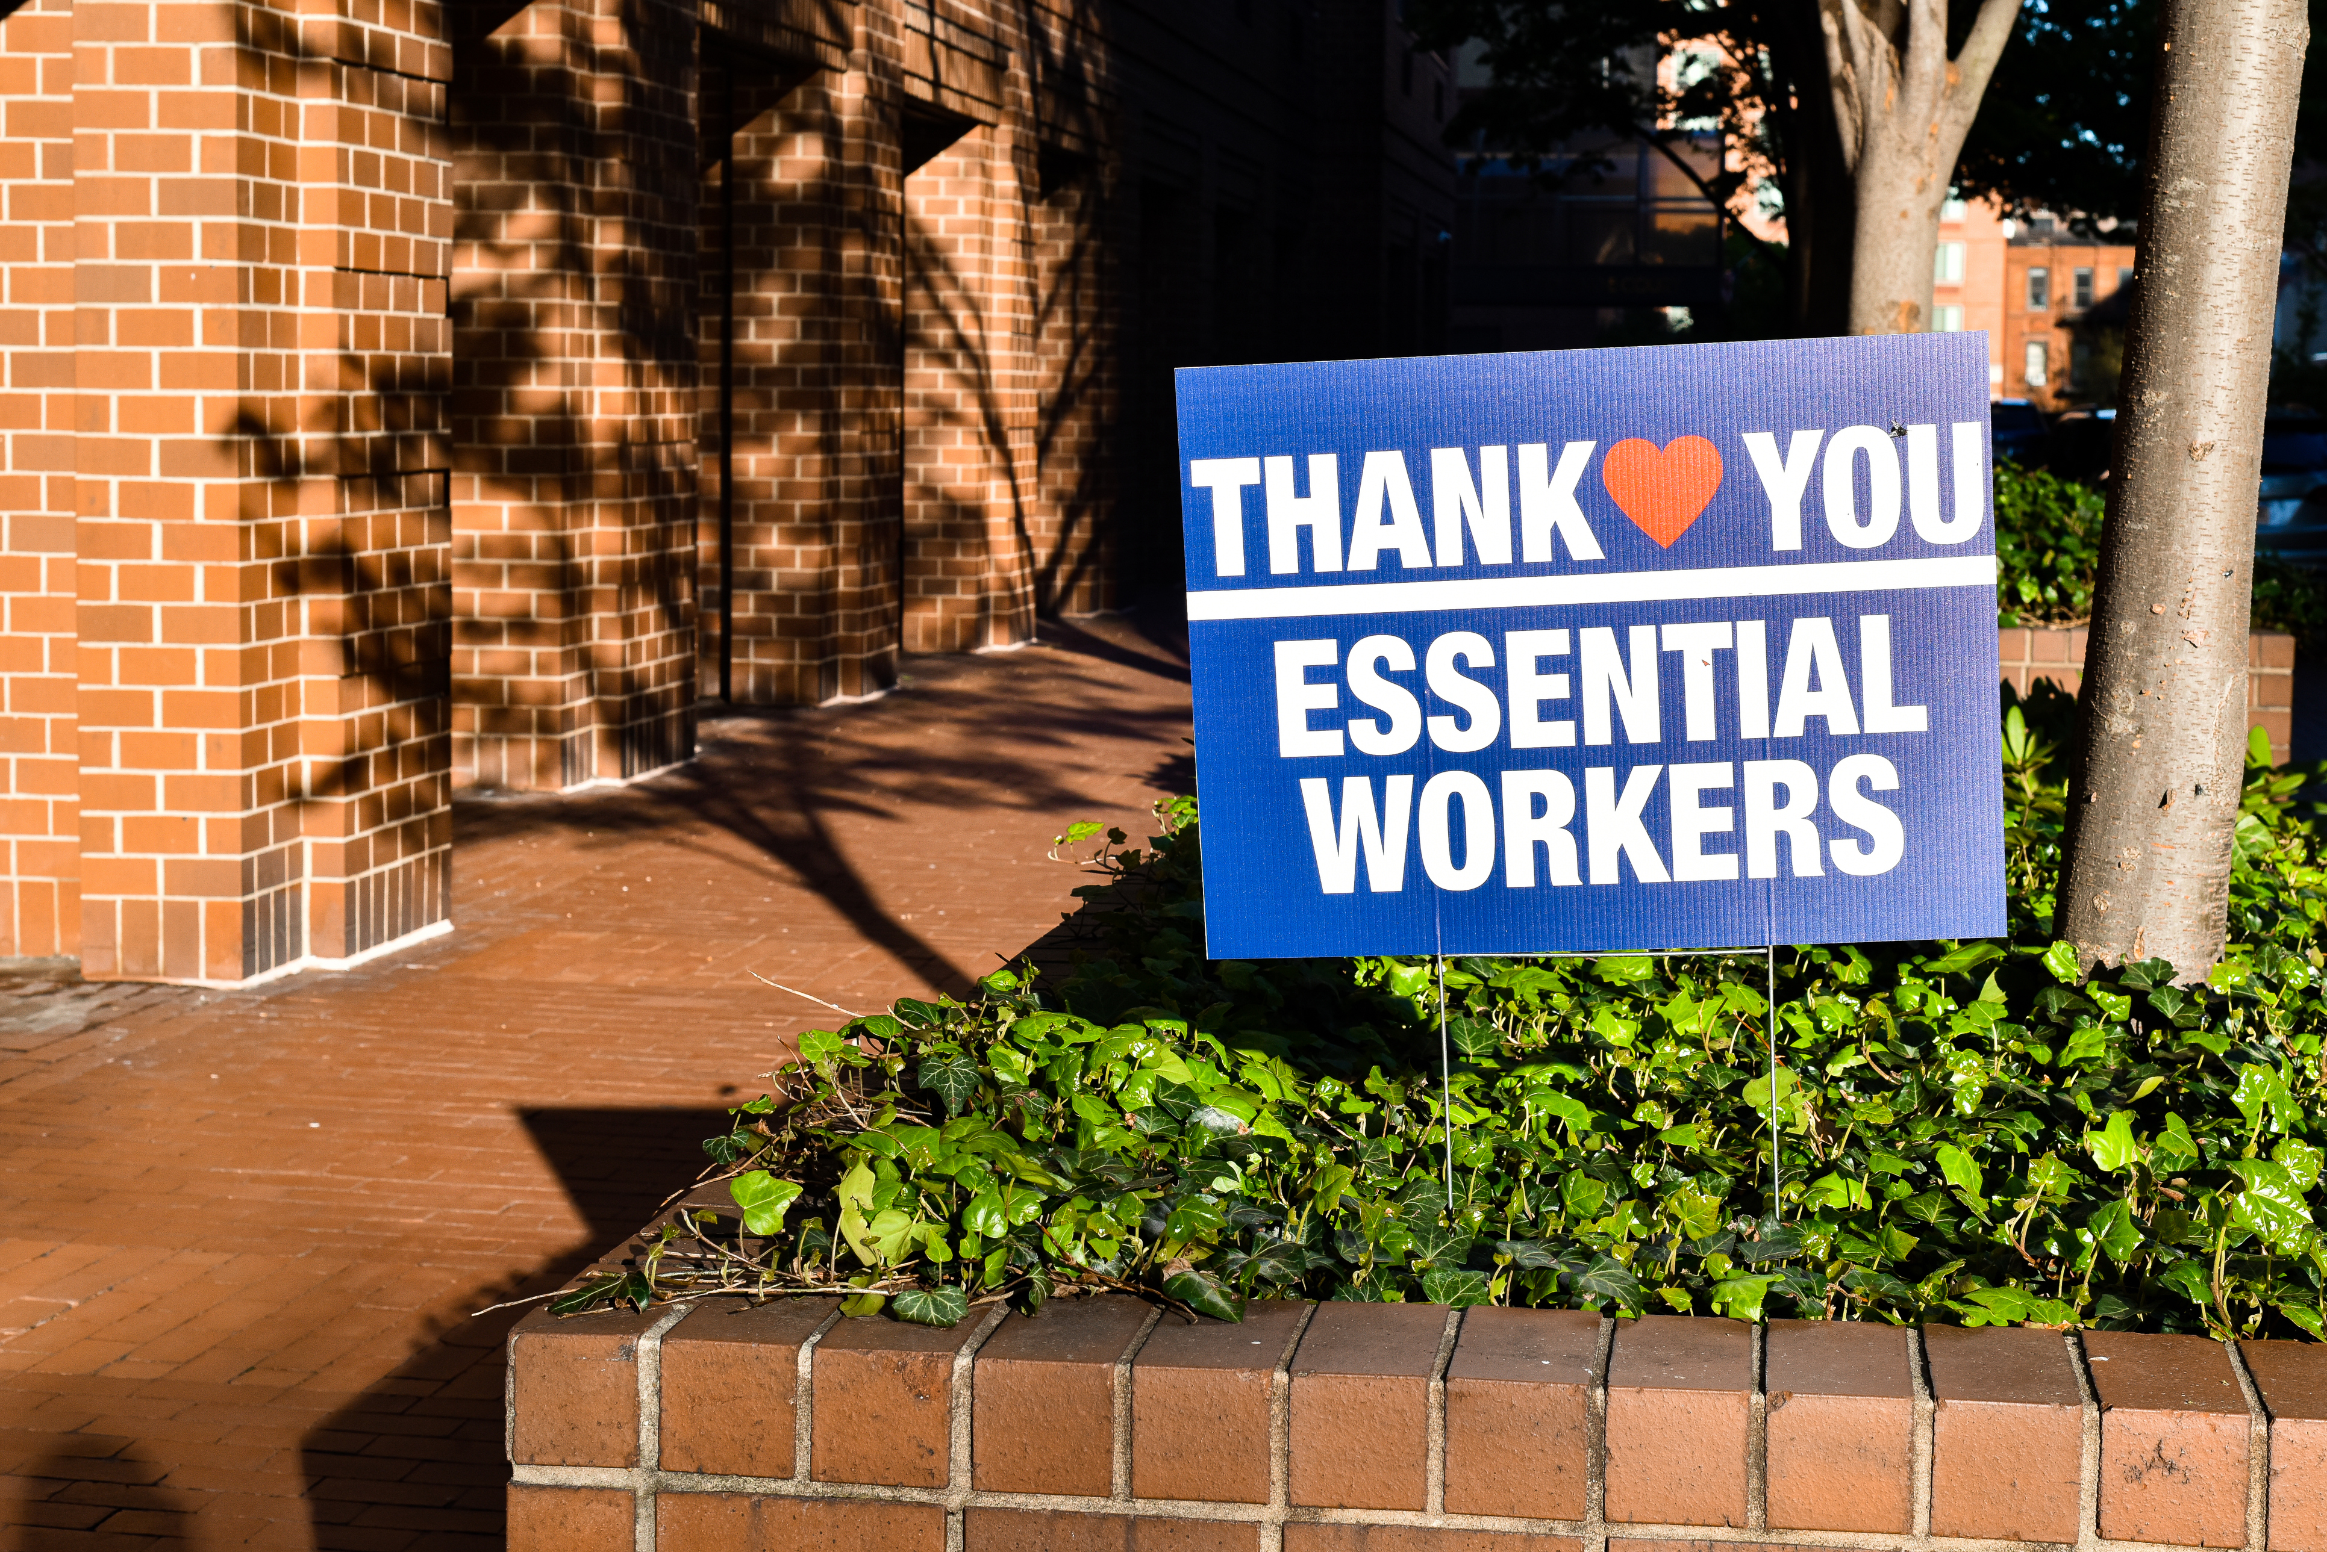
Thank
You
Special thanks:
Jason Hansman, Director, Social Service Initiatives, Mayor’s Office of ThriveNYC
Catherine Clarke, Program Manager, Social Service Initiatives, Mayor’s Office of ThriveNYC

Slide 23

Panel Discussion and Q&A
Please share your questions
Are there tools we did not mention that you find helpful?
What additional resources would help?
Panelists
  Monika Eros-Sarnyai, MD, MA, Best Practices Specialist in Disaster Preparedness and Response, NYC Department of Health and Mental Hygiene
  Michael Fisher, MSW, Chief Officer, Readjustment Counseling Service, Veterans Health Administration
  Robert J. Ursano, MD, Director, Center for the Study of Traumatic Stress & Professor of Psychiatry and Neuroscience, USUHS
Notes:
Normalizing this is key: you aren’t alone
You aren’t alone. Hopefully hearing from others will help you learn new things to try in the moment

Slide 24
Resources
Ursano, R.J., Fullerton, C.S., Weisaeth, L., Raphael, B. (Eds.). (2017). Textbook of Disaster Psychiatry, 2ED. London, UK: Cambridge University Press
https://optionb.org/build-resilience/lessons/the-importance-of-resilience
Morganstein, J. C., Fullerton, C. S., Ursano, R. J., & Holloway, H. C. (2017). Pandemics: Health Care Emergencies. In Textbook of Disaster Psychiatry (2nd ed., pp. 270–284). Cambridge University Press.

