Slide 1
Critical Care Aspects of COVID-19
Lifesaving treatment and clinical operations
Vikram Mukherjee, MD
Director, Medical ICU, Bellevue Hospital Center
Director, Special Pathogens Program, Bellevue Hospital Center

Slide 2
Clinical aspects: overall impressions so far
Full spectrum of ages and ethnicities
Many more young patients than anticipated
Gender M>F
Common progression of disease
25% of hospital admissions admitted to ICU

Slide 3
Onset of symptoms
Presentation to ER
Admitted to floor
Worsening hypoxia
Admitted to ICU
Severe ARDS
Cytokine Storm
Renal failure
Ongoing ventilator and RRT needs
Death

Slide 4
Onset of symptoms
Presentation to ER
Admitted to floor
Worsening hypoxia
Onset of symptoms
Presentation to ER
Admitted to ICU
Severe ARDS
Cytokine Storm
Renal failure
Ongoing ventilator and RRT needs
Death

Slide 5
Severe ARDS
Conventional management:
Trial of HFNC
Lung Protective Strategy
High peep/fio2 ladder, though some patients improve on lower PEEPs
Account for insensible losses and undetected hypovolemia
Recruitment
Sustained hyperinflation method
Attention to fluid balance
Trial of antibiotics
Neuromuscular blockade and RASS-4 sedation
iNO for refractory hypoxia
Manual proning

Slide 6
Severe ARDS
Other issues
CVL and A-line in most patients
Prefer left IJ CVL
Many have substantial sedation requirements
Many need neuromuscular blockade to achieve ventilator dysynchrony
Tracheostomy team with protocolized bedside PDT
Plaquenil/Azithromycin
Watch Qtc
Family updates

Slide 7
Cytokine Release Syndrome
Common to see the following a few days into ICU course
Recurring marked fevers in the absence of obvious infectious source
Tachycardia, tachypnea, diaphoresis
Elevated CRP, ferritin, LDH, IL-6
Trend daily (except IL-6)
D-Dimer
Progression to renal failure
~50% of our ICU patients are in acute renal failure requiring RRT
Unclear on how to mitigate
Steroids
Risks
Anti- IL6
No clear data on efficacy

Slide 8
Role of Tocilizumab
∞ Tocilizumab (anti-IL6R) 400mg IV x1 for severe CRS
MUST have:
Confirmed SARS-CoV-2
Bilateral pulmonary infiltrates
Need for supplemental O₂ to maintain sat >92% or PaO2/FiO2 <300mmHg
and at least 2 of following:
CRP >100 or >50 but doubled in past 48hrs
LDH >250
Ferritin >500
D-dimer >1000ng/mL
Lymphocyte count <0.6x10⁹/L
Avoid in patients w/other active infections
See page 3 BEFORE initiating immunomodulator

Slide 9
Other considerations
No evidence based treatment
Critical care support is the mainstay of therapy
Altered standard of care
Role of POCUS
Things move slowly
Has repercussions on management choices
Levels of sedation
Timing of invasive interventions

Slide 10
Clinical Operations
Space
Ability to cohort
Need for negative pressure ICU capable beds
Staff
Strain on physician and nurses capacity
Stuff
PPE
Equipment

Slide 11
MICU
NSICU
SPACE
CCU
SICU

Slide 12
SPACE [n=54]
COVID ICU
COVID ICU
COVID ICU
COVID ICU

Slide 13
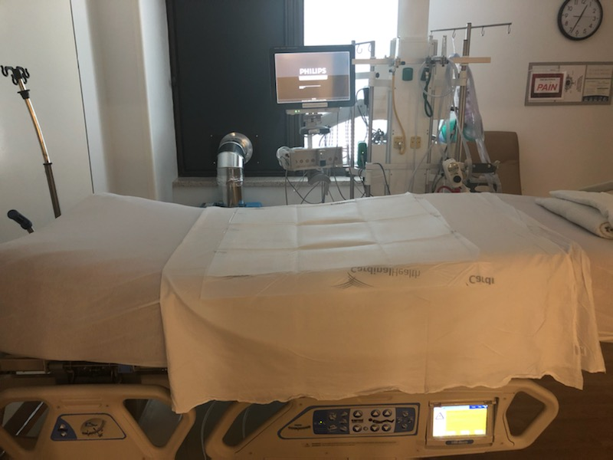

Slide 15
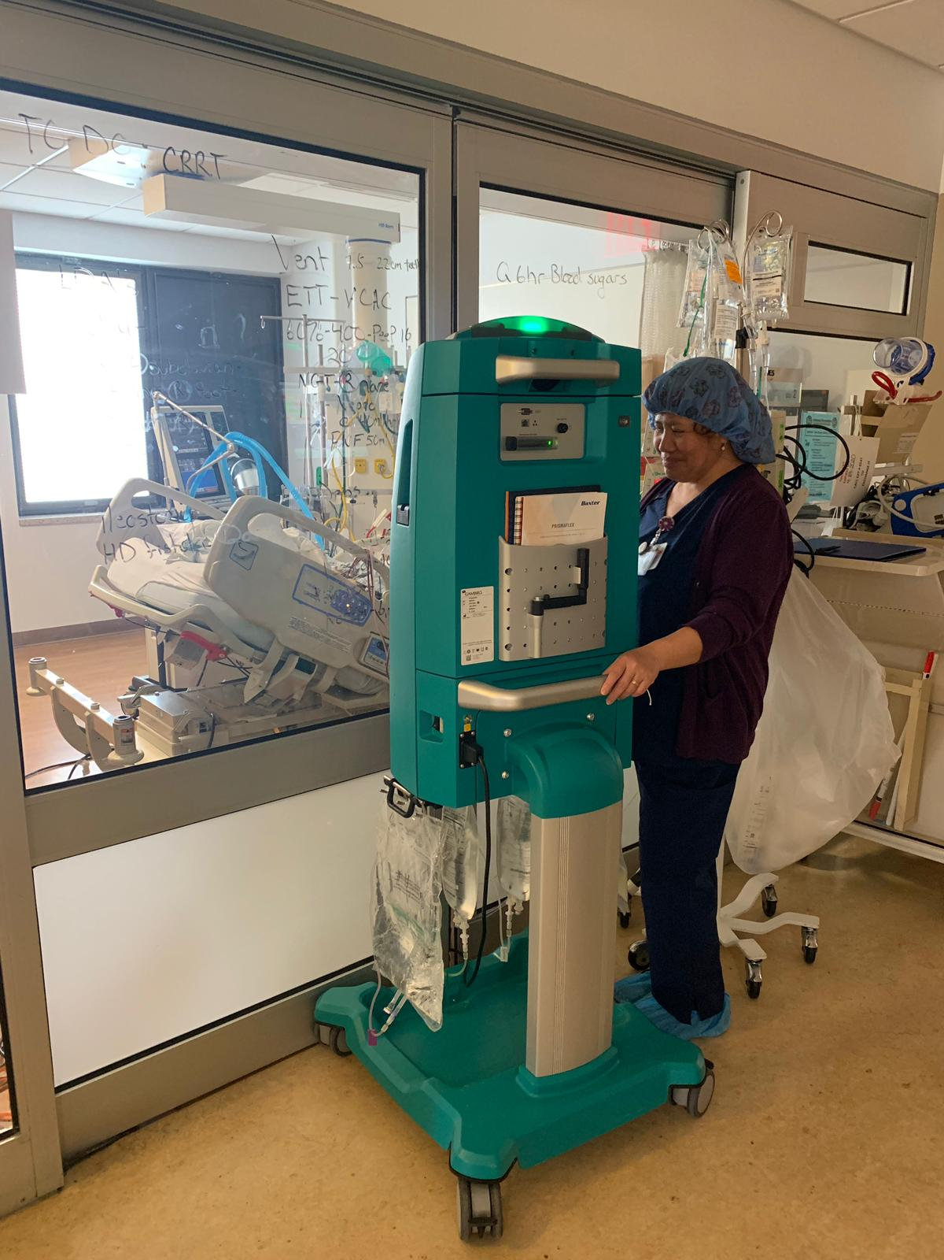

Slide 16
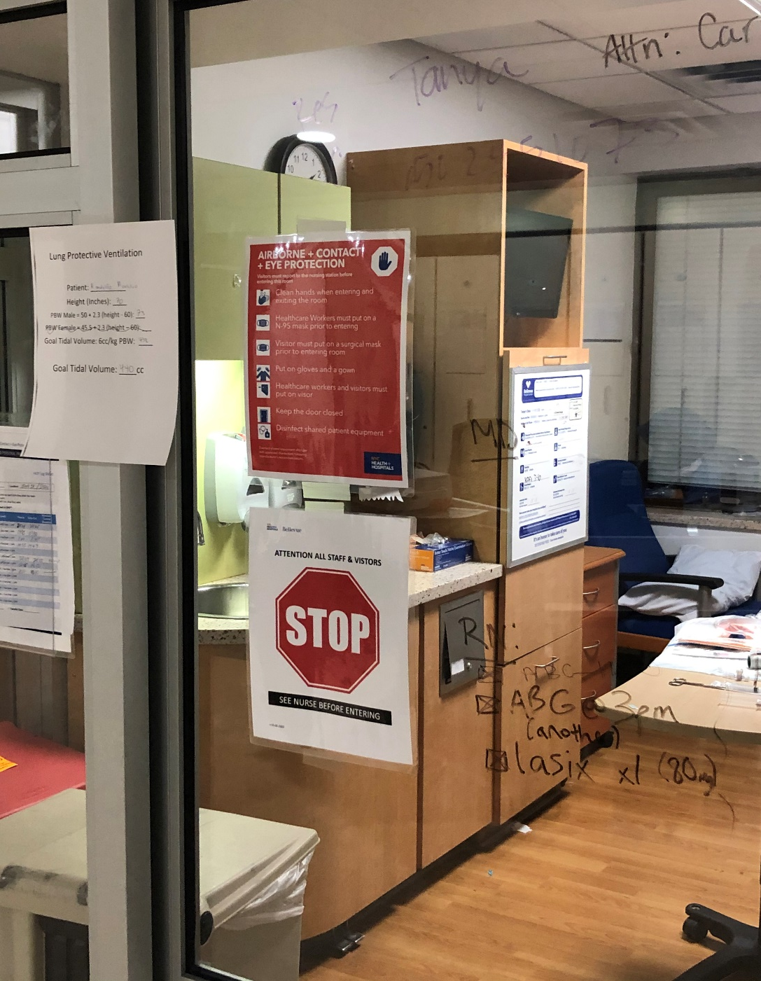

Slide 17
STUFF
INTUBATION KITS

Slide 18
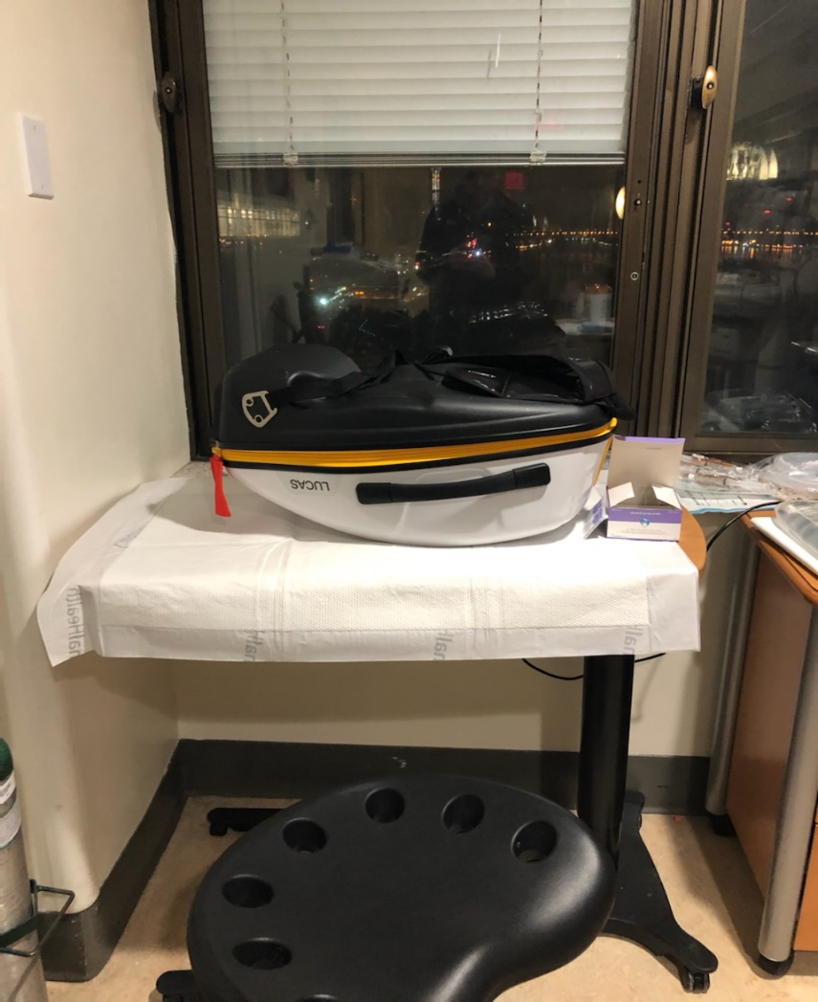
STUFF
INTUBATION KITS
MECHANICAL CPR

Slide 19
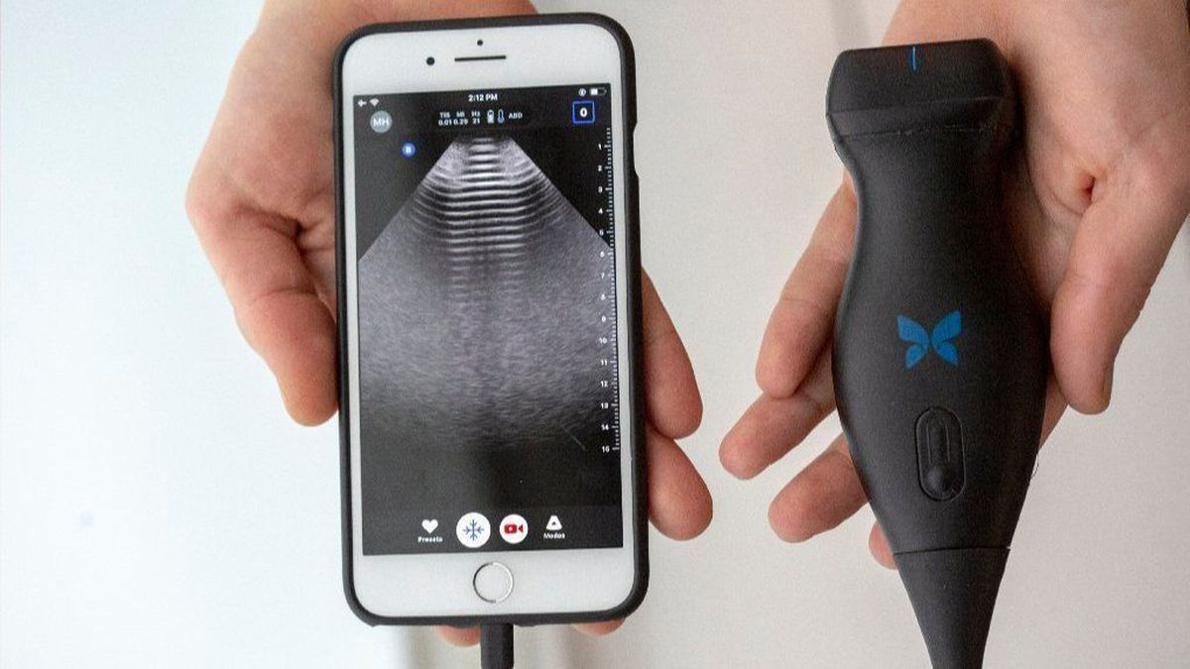
STUFF
INTUBATION KITS
MECHANICAL CPR
Butterfly

Slide 20
Stuff: unanticipated shortages
IV pumps
Cooling blankets
CVVH machines
Medications
Fentanyl, cisatracurium

Slide 21
Dashboards

Slide 22
STAFF

Slide 23
DON’T SAY NO TO ANYONE!
Orthopedic surgeons= Proning teams
Outpatient Nurse Practitioners= CVVH support
Anesthesia= procedure team (Airway, CVL, A-line, HD line, OG tube)
ENT/Intervention Pulm= Tracheostomy Team
Psych/Palliative Care= Family contact team
Students= “Write up papers” team

Slide 24
Staffing
Account for:
Staff falling sick
Low morale
Sick call
Stress on:
Team building
Lead by example
Perform non-physician tasks
Emergency credentialing

Slide 25
Have Plans B and C ready before Plan A runs out
Surge
Space
Stuff
Staff

Slide 26
Clinical care: no obvious right answers
Levels of sedation
Blocking the cytokine storm
Central access
Anticoagulation
End of Life Care

Slide 27
Delegate and build autonomous teams
Tracheostomy team
Proning team
Palliative care team
Procedure team
Renal Replacement Therapy Team
Site manager team

Slide 28
Plan for staff well being
Morale will take an inevitable hit
HCWs falling sick
Death
Team building exercises
Process groups
Emphasize the smallest wins
Recognize burnout among colleagues (and yourselves)

Slide 29
Build a community
H+H experience
Ability to handle surge
Equipment sharing
NYC ICU Community
Internal data and process sharing
Standardize care

Slide 30
Questions

