Slide 1
COVID-19 DISCUSSION FOR ICU DIRECTORS
Corinne Thompson, PhD
Lead, Epidemiology Data Branch

Slide 2
DISCLAIMER
Our understanding of the novel coronavirus is evolving rapidly
This presentation is based on our knowledge as of April 8, 2020, 5:00PM

Slide 3
CURRENT STATUS OF OUTBREAK NYC
Cases: 80,204
Total hospitalized*: 20,474
Deaths: 4,260
*Estimated

Slide 4
COVID-19 CASES NYC BY ZIP CODE

Slide 5
COVID-19 PERCENT OF PATIENTS TESTING POSITIVE BY ZIP CODE

Slide 6
NYC CASES COVID-19

Slide 7
NYC CASES OVER TIME COVID-19
CASES
HOSPITALIZED
Due to delays in reporting, recent data are incomplete
DEATHS

Slide 8
NYC RATES BY BOROUGH COVID-19

Slide 9
NYC CASE RATES BY AGE GROUP COVID-19

Slide 10
NYC HOSPITAL RATES BY AGE GROUP COVID-19

Slide 11
NYC DEATH RATES BY AGE GROUP COVID-19

Slide 12
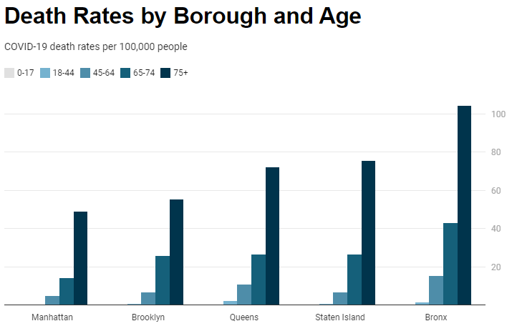
NYC DEATH RATES BY BOROUGH AND AGE GROUP COVID-19
Rates of laboratory confirmed COVID-19 deaths per 100,000 people by age group and borough. Deaths among 75+ year olds in the Bronx much higher compared to the rest of NYC.

Slide 13
DEATH SURVEILLANCE
Not all persons infected with SARS-CoV-2 are diagnosed with COVID-19
Routinely capture laboratory confirmed COVID-19 cases
To capture possible COVID-19 cases
Review of death certificates
Review excess mortality compared to expected mortality
Possible cases will soon be added to total death count

Slide 14
NYC DEATH RATES BY RACE/ ETHNICITY COVID-19
Rates of laboratory confirmed COVID-19 deaths per 100,000 people by race and ethnicity

Slide 15
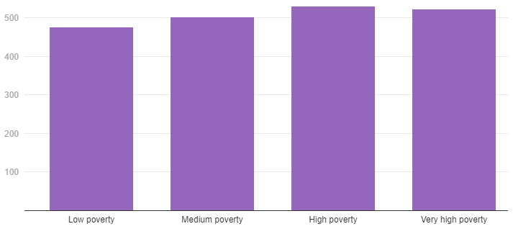
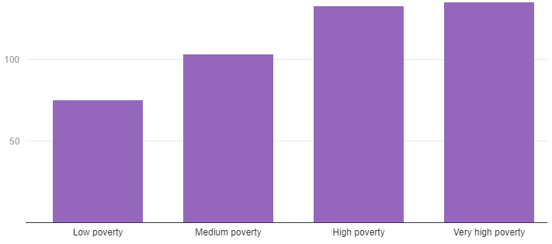
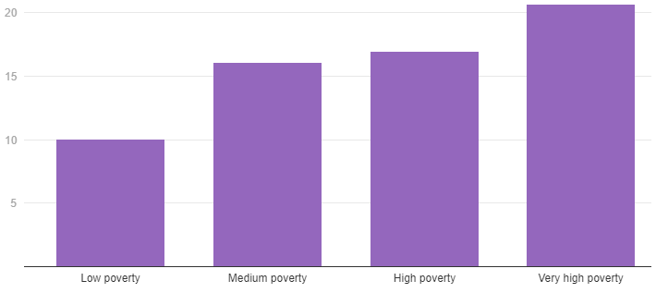
NYC RATES BY NEIGHBORHOOD LEVEL OF POVERTY COVID-19
CASES
HOSPITALIZED
Rates of laboratory confirmed cases, hospitalizations and death of COVID-19 per 100,000 people by neighborhood poverty. Case rates are similar among neighborhood poverty levels but rates of hospitalization and death are higher in neighborhoods of very high poverty compared to low poverty.
DEATHS

Slide 16
Crisis Communication Resources
Center to Advance Palliative Care (CAPC)
Mount Sinai Icahn School of Medicine
Publicly available COVID-19 Response Resources toolkit
Protocols and guidance on crisis communication and tools to help palliative care teams address high levels of volume and stress during a crisis

Slide 17
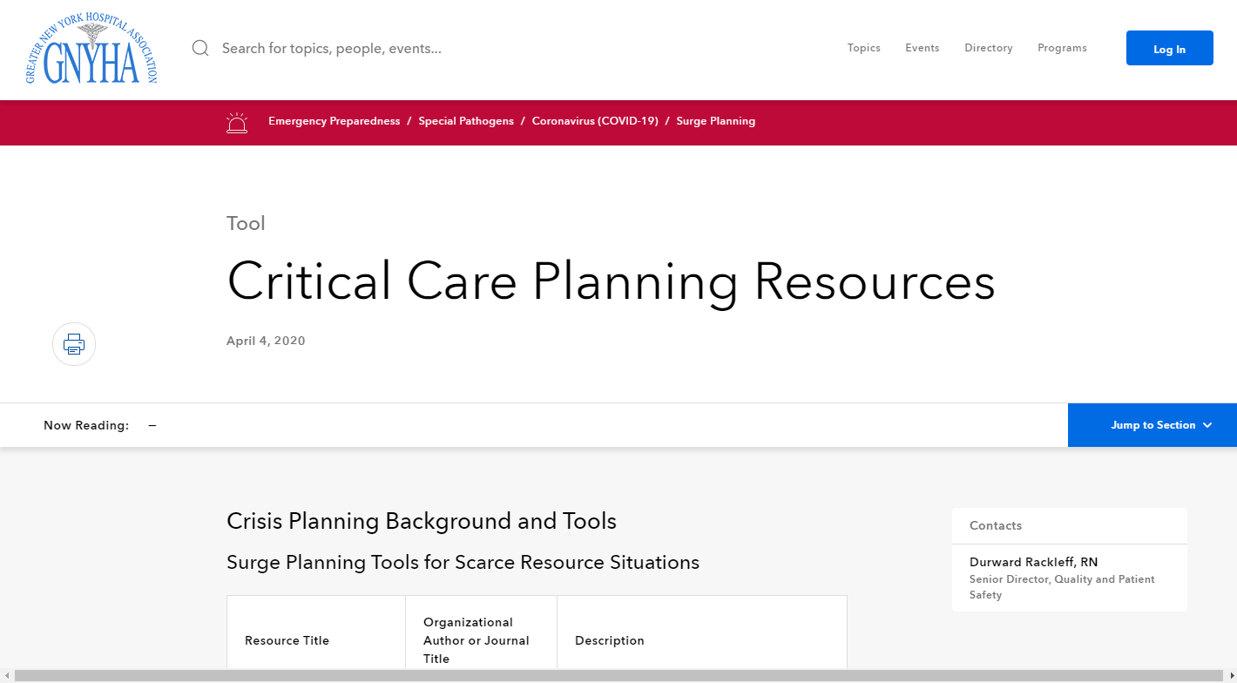
https://www.gnyha.org/tool/critical-care-planning-resources/
Notes:
DOHMH has worked with GNYHA to develop a library of resources and strategies from NYC and around the country
Most useful resources for developing and implementing crisis strategies.

Slide 18
Notes:
Can go to a particular section by clicking “Jump to Section”
Resources categorized into Crisis Planning Background, Space/Staff/Supply Surge Strategies
Plan to update once weekly
Send us new resources/comments through GNYHA

Slide 19
QUESTIONS?

