Slide 1
COVID-19 Grand Rounds:
Special Considerations for the Perinatal Patient
March 23, 2020

Slide 2
Please note all lines have been muted due to volume of participants on the webinar
____________
Please type your questions in the Q&A box on the right side of the screen and your question will be read to the presenters by a facilitator

Slide 3
Agenda
Topic | Speaker
Welcome and Introductions | Lorraine Ryan, GNYHA
Northwell Health: Overview of COVID-19 in Pregnancy Case Presentation: COVID-19 in a Pregnant Patient Ambulatory and Inpatient Considerations and Challenges | Northwell Team Burton Rochelson, MD & Andrew Rausch, MD Sumithra Jeganathan, MD Michael Nimaroff, MD, MBA
ACOG: COVID Resources | Christa Christakis, ACOG District II
NYSDOH Updates | Marilyn Kacica MD MPH Lauren J. Tobias MPP
Telehealth Guidance & Resources | Jeanne Alicandro MD, MPH, NYSDOH Puja Khare, GNYHA
Q&A

Slide 4
Please note all lines have been muted due to volume of participants on the webinar
____________
Please type your questions in the Q&A box on the right side of the screen and your question will be read to the presenters by a facilitator

Slide 5
Clinical Considerations for the COVID-19 Perinatal Patient
Adriann Combs DNP, NNP-BC
Natalie Meirowitz MD
Burton Rochelson MD
Andrew Rasuch MD
Sumithra Jeganathan MD
Michael Nimaroff MD, MBA

Slide 6
Coronavirus & Pregnancy
Michael L. Nimaroff, MD
Burton Rochelson, MD
Natalie Meirowitz, MD
Sumithra Jeganathan, MD
Adriann Combs, DNP, NNP-BC
Northwell Health OBGYN Service Line

Slide 7
Agenda
Overview of COVID-19 in Pregnancy
Case Presentation: COVID-19 in Pregnancy
Ambulatory & Inpatient Considerations and Challenges
1
B. Rochelson, MD
N. Meirowitz, MD
S. Jeganathan, MD
2
M. Nimaroff, MD
A. Combs, DNP, NNP
3

Slide 8
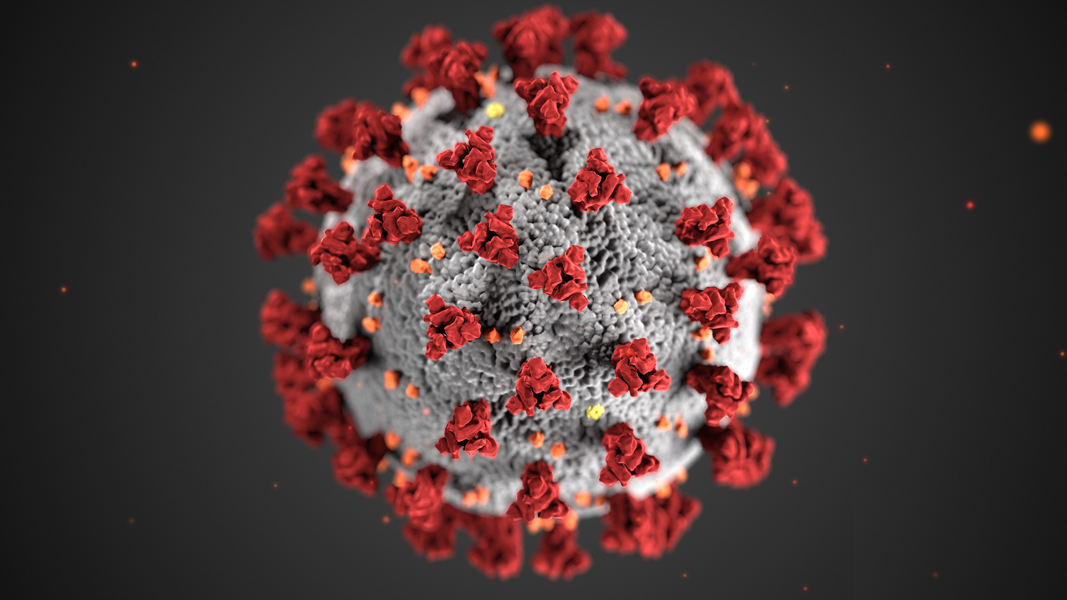
Coronavirus in Pregnancy
Burton Rochelson, MD
Chief, Maternal-Fetal Medicine
Northwell Health
March 23rd, 2020

Slide 9
Ireland DoH

Slide 10
Effect of Coronavirus on Pregnant Mothers
Symptoms are similar to those in the non pregnant population
  Fever, cough, myalgia
  Leukopenia, lymphocytopenia
  Some may be asymptomatic (2/15 in Yang et al)
Pregnant women don’t appear to be more susceptible to getting COVID-19 than the general population
Theoretically pregnant women may be at increased risk of severe disease because of their immunocompromised state - the incidence of severe disease in pregnancy is unclear
Recently 5 women in pregnancy or postpartum in critical condition in NY area
  Small series in three articles
    Chen et al; Liu et al; Yang et al

Slide 11
Coronavirus Symptoms in Pregnancy
Study → Symptom ↓ | Chen et al. (Lancet) | Liu et al. (J of Infection) | Yang et al. (Lancet)
Total Patients | 9 | 3 | 15
Fever | 7 (77%) | 2 (67%) | 13 (87%)
Cough | 4 (44%) | 2 (67%) | 9 (60%)
Myalgia | 3 (33%) | NR | 3 (20%)
Malaise | 2 (22%) | NR | NR
Dyspnea | 1 (11%) | NR | 1 (7%)
Diarrhea | 1 (11%) | NR | 1 (7%)
Asymptomatic | Not reported (NR) | NR | 2 (13%)

Slide 12
Coronavirus Laboratory Findings
Study → Characteristics ↓ | Chen et al. (Lancet) | Liu et al. (J of Infection) | Yang et al. (Lancet)
Leukopenia | 7 (78%) | 0 | 12 (80%)
Lymphocytopenia | 5 (56%) | 0 | 0
Elevated CRP | 6 (75%) | 2 (67%) | 10 (67%)
Transaminitis | 3 (33%) | 0 | NR
SARS-CoV-2 qRT-PCR + | 9 (100%) | 3 (100%) | 15 (100%)

Slide 13
Coronavirus Obstetric & Clinical Findings
Study → Characteristics ↓ | Chen et al. (Lancet) | Liu et al. (J of Infection) | Yang et al. (Lancet)
Mode of Delivery | Cesarean 9 (100%) Vaginal 0 (0%) | Cesarean 2 (67%) Vaginal 1 (33%) | Cesarean 10 (91%) Vaginal 1 (9%) 4 still pregnant
Maternal O2 support | 9 (100%) | 3 (100%) | 10 (67%)
Fetal Distress | 3 (33%) | 1 (33%) | NR
Apgar Score | 1 min (8-9) 5 min (9-10) | 1 min (8) 5 min (9) | 1 min (8) 5 min (9)

Slide 14
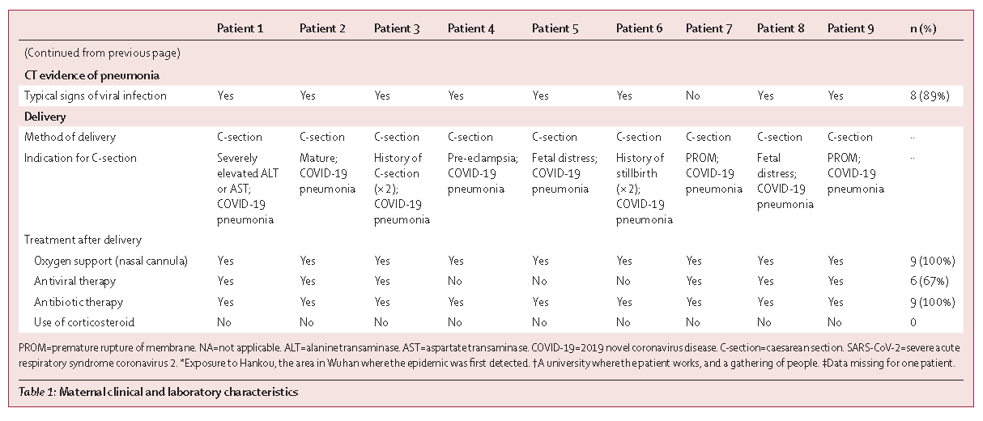
CoVID-19 + Pregnancy: Chen, et al

Slide 15
CoVID-19 + Pregnancy: Zhu, et al.
N = 9 pregnancies → 10 neonates
Symptom onset:
  Before delivery = 4; Day of = 2; After = 3
  Fever and cough; 1 with diarrhea
Term = 4; Preterm = 6
  SOB = 6; Fever = 2; Thrombocytopenia = 2; Tachycardia = 1, Pneumothorax = 1, Vomiting = 1
Negative SARS-CoV2 swabs = 9
1 death (34+5/7, DOL #8 multiorgan failure, DIC, Shock)
Transl pediatr. 2020 Feb;9(1): 51-60. doi: 10.21037/tp.2020.02.06.
Clinical analysis of 10 neonates born to mothers with 2019-nCoV pneumonia.
Zhu H ¹, Wang L ², Fang C ³, Peng S ¹, Zhang L ⁴, Chang G ⁵ , Xia S ¹, Zhou W. ⁶

Slide 16
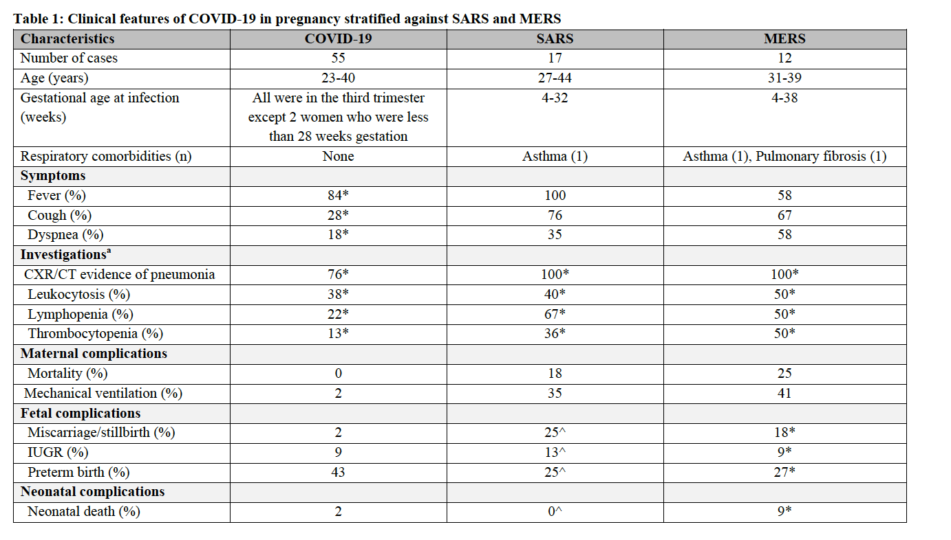
Dashrath, P., & Jeslyn, W. (2020). Coronavirus Disease 2019 Pandemic and Pregnancy.
ACOG, Prepublication.

Slide 17
Current Pregnancy Data Summary
Available data are reassuring but are limited to small case series.
1
2
Susceptibility of pregnant women to COVID-19
Severity of infection
Denominator unknown
Coronavirus (COVID-19) and Pregnancy: What Maternal-Fetal Medicine Subspecialists Need to Know
The Society for Maternal-Fetal Medicine (SMFM); Sarah Dotters-Katz, MD, MMHPE; and Brenna L. Hughes, MD, MSc.

Slide 18
Effect of Coronavirus on the Fetus
Vertical transmission has not been identified
  Cord blood, amniotic fluid, breast milk were tested in the above series, and were negative Previous studies on SARS and MERS did not demonstrate perinatal SARS infections in infants born to infected mothers
It is likely that based on studies on the ACE2 enzyme receptor (which is vital for coronavirus-19 infection) in cells of the maternal-fetal interface, it is unlikely that maternal infection can lead to vertical transmission
Cautions:
1
2
3
  Very small sample size
  High fevers in the first trimester may be teratogenic
  Limited data on the incidence of spontaneous abortion

Slide 19
Effect of Coronavirus on the Newborn
Limited case reports
Preterm birth.
Extrapolated data:
Influenza: LBW, PTB.
Not clear that these outcomes were related to maternal infection, and at this time the risk of adverse infant outcomes is not known.
SARS-CoV and MERS-CoV: SGA or PTB
High fever early in pregnancy may increase the risk of certain birth defects.
Limited data on Pediatric patients with
CoVID-19
Some adverse outcomes have been reported, but may have been unrelated.
Limited data on coronavirus & adverse outcomes
See next slide.

Slide 20
Effect of Coronavirus on the Pediatric Population
Disease Severity ???
Dong, Y. et al. Epidemiological Characteristics of 2143 Pediatric Patients With 2019 Coronavirus Disease in China. Pediatrics. 2020.

Slide 21
Strategies for Prenatal Period,
Labor & Delivery,
& Postpartum

Slide 22
Limiting Prenatal Visits-Principles & Caveats
Reducing the number of prenatal visits, obstetrical ultrasounds, and antepartum testing procedures- while maintaining safety

Slide 23
Summary of Suggested Prenatal Visit Timing in Setting of COVID
Gestational Age | In-person OB Visit | Ultrasound | Comments
<11 weeks* |  |  | Telephone Intake
11-13 weeks** | X | X (Dating/NT) | Initial OB Labs
20 weeks | X | X(Anatomy)
28 weeks | X |  | Labs/Vaccines
32 weeks | X | X (if indicated)
36 weeks | X | X (if indicated) | GBS/HIV Screening
37 weeks-Delivery | x |  | Weekly
Postpartum |  |  | Telehealth
Visits including follow up of diabetes control, hypertension, mood disorder, etc. should be accomplished remotely with telehealth)
*Earlier scan may be indicated if at risk for ectopic
**If viability previously established consider skipping 11-13 week scan and offer cfDNA
Boelig RC, Saccone G, Bellussi F, Berghella V, MFM Guidance for
COVID-19, American Journal of Obstetrics & Gynecology MFM (2020), doi: https://doi.org/10.1016/

Slide 24
Limiting OB Ultrasounds
Dating and Ultrascreen : 11-14 weeks
Anatomy Ultrasound: 20-23 weeks
  *Suboptimal scans to return once before 26weeks, if possible
  * BMI greater than 40, schedule initial scan at 22 weeks
  * Transabdominal screening for cervical length. Use TVS if cervical length less than 3.0 cm, or if risk factors are present
*These are meant as minimal guidelines only—individual patient or fetal circumstances may indicate more frequent surveillance starting at an earlier gestational age or a change in the optimal testing modality.

Slide 25
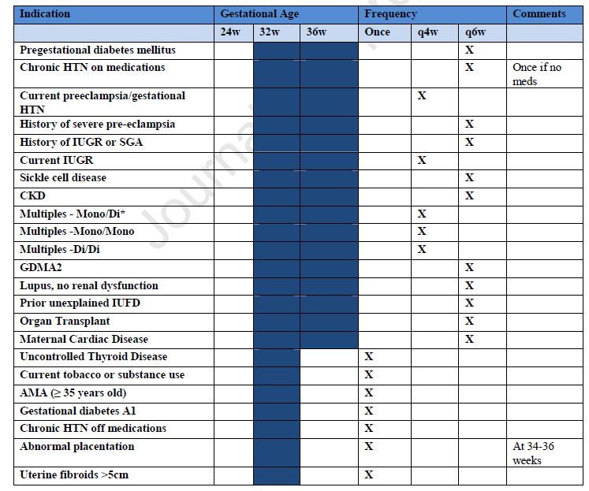
Guidelines for Ultrasounds During the COVID 19 Pandemic
Boelig RC, Saccone G, Bellussi F, Berghella V, MFM Guidance for
COVID-19, American Journal of Obstetrics & Gynecology MFM (2020), doi: https://doi.org/10.1016/

Slide 26
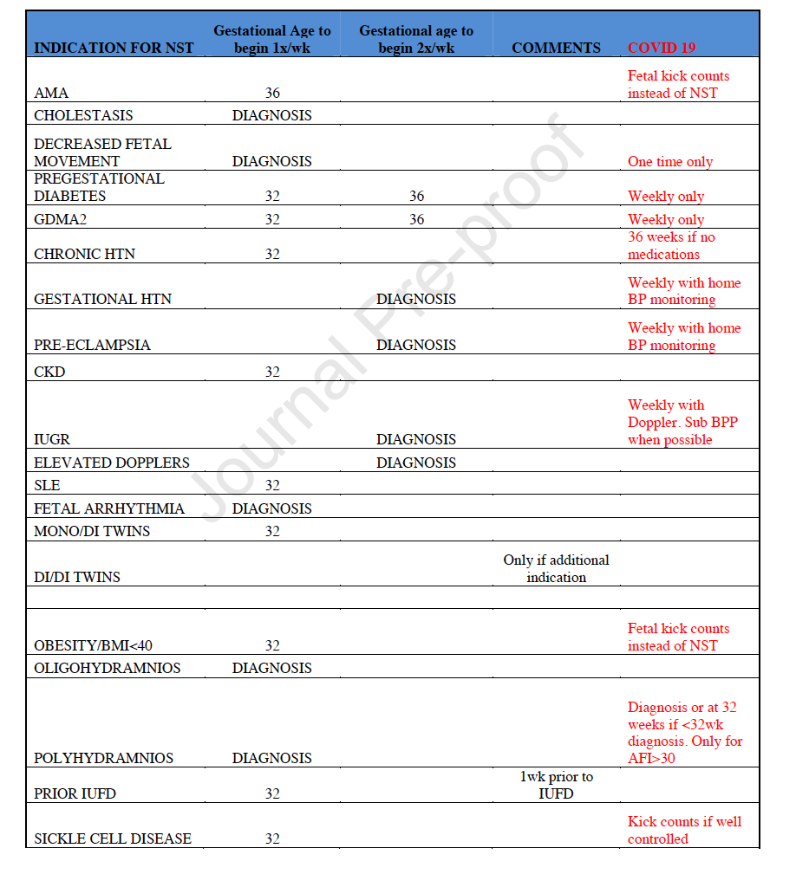
Guidelines for Antepartum Testing During
COVID 19 Pandemic
Boelig RC, Saccone G, Bellussi F, Berghella V, MFM Guidance for
COVID-19, American Journal of Obstetrics & Gynecology MFM (2020), doi: https://doi.org/10.1016/

Slide 27
Delivery in Mothers with Coronavirus
1
2
Route of delivery should be based on clinical circumstances
Forceful exhalation may significantly reduce the efficacy of patient face masks in reduces viral spread from respiratory droplets
3
4
All medical staff should wear PPE (gown, N95 masks when available, goggles and or face shields, gloves)
In critical situations, continuing the pregnancy may endanger mother and/or fetus and early delivery may be indicated (Liang & Acharya)

Slide 28
Mode of Delivery-Coronavirus in Pregnancy
There is currently no contraindication to vaginal delivery
Consider the extra time required to don PPE and prepare an operating room for emergency surgery should fetal distress occur
Timing of Delivery-Coronavirus in Pregnancy
There is currently no indication for early delivery due to Coronavirus

Slide 29
Elective Inductions
+
Deliver patients now in order to decrease patient load, before burden of disease increases in next few weeks
-
Increased time in medical setting, load on L&D now
Outpatient Induction?

Slide 30
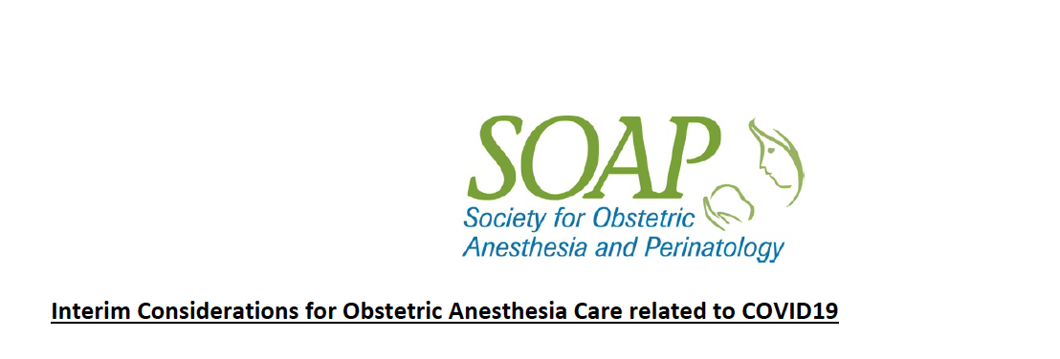
OB Anesthesia Guidelines for COVID-19
Interim considerations for obstetric anesthesia care related to COVID19:
Early epidural analgesia may reduce the need for general anesthesia for emergent cesarean delivery
A COVID19 diagnosis itself is NOT considered a contraindication for neuraxial anesthesia. Avoid emergent cesarean deliveries as much a possible - proactive communication with obstetrical and nursing teams. For respiratory distress intubate early using appropriate PPE
Assign the most experienced anesthesia provider whenever possible for procedures (neuraxial, intubation)
Consider minimizing use of trainees in direct care of COVID19 patients. Minimize the number of personnel in the room.

Slide 31
Special Issues:
Coronavirus in Pregnancy

Slide 32
Management of Coronavirus in Pregnancy: Treatment?
Chloroquine and hydroxychloroquine show some benefit in early studies from China (less progression to mechanical ventilation), and is being used in our ICUs (Cortegiani et al).
  While considered safe in pregnancy, hydroxychloroquine has not been studied in this population for treatment for coronavirus
No approved antiviral therapies currently exist for this coronavirus
Available RCTs for remdesivir do not include pregnant patients, though it was used for some postpartum patients in China
Lopinavir + ritonavir have been used as broad spectrum antivirals but no data regarding efficacy is currently available

Slide 33
Corticosteroids for Fetal Lung Maturity?
No current recommendation to avoid steroids for fetal lung maturity: continue administering betamethasone as per protocol
  In SARS and MERS patients, there was conflicting data regarding corticosteroid efficacy and even possible harm
  No such evidence of harm currently exists regarding the 2019 coronavirus, but data is limited
Individualize
  Use late term corticosteroids with caution

Slide 34
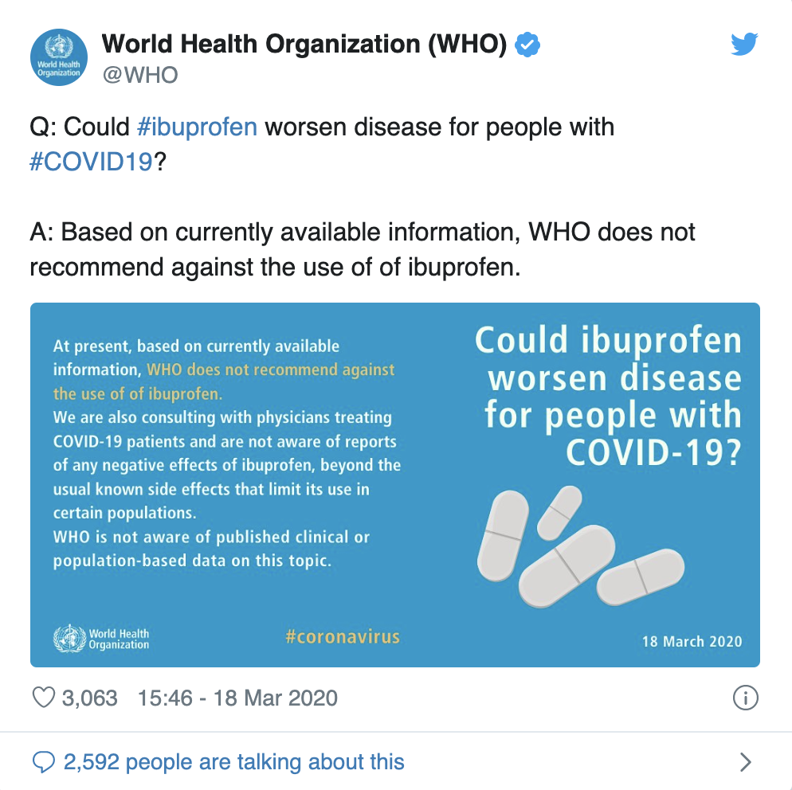
Use of NSAIDS?
News reports recommending against treatment with ibuprofen and other NSAIDs do not appear to be evidence based: May continue using ibuprofen for postpartum pain control

Slide 35
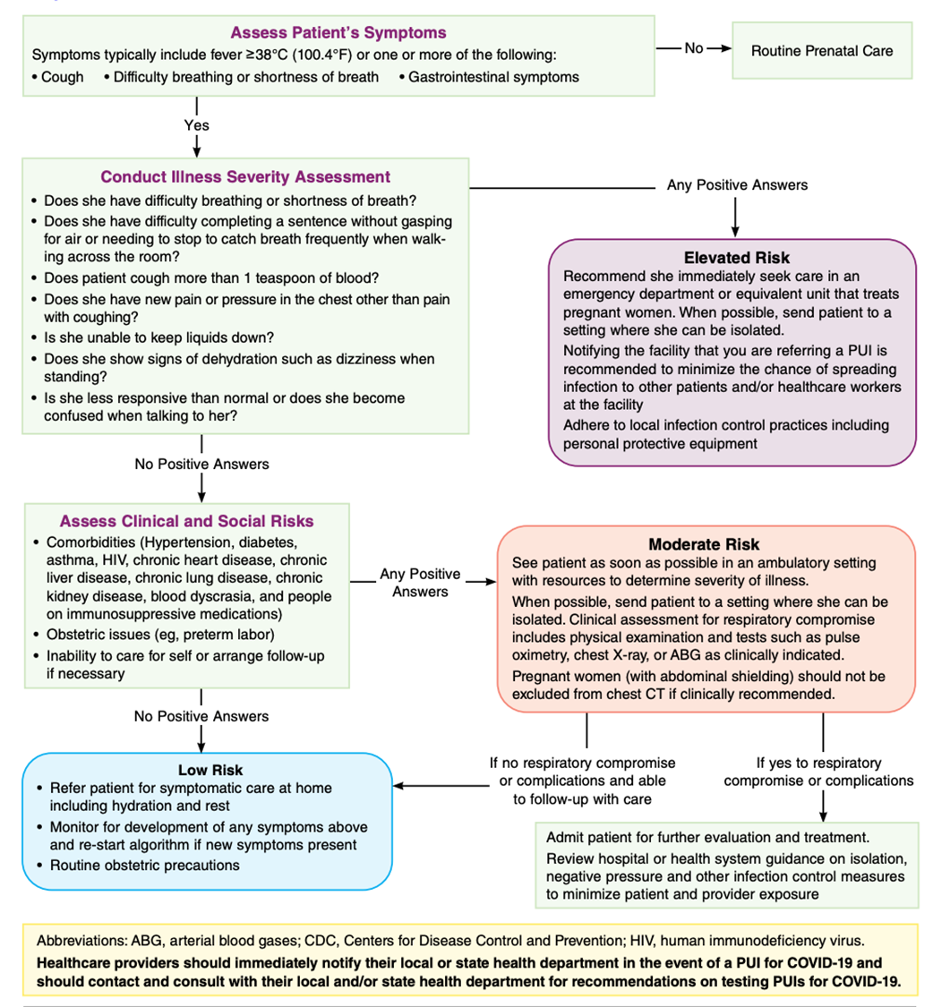


Guidance:

Slide 36
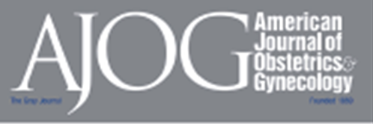
Guidance
Coronavirus (COVID-19) and Pregnancy: What Maternal-Fetal Medicine Subspecialists Need to Know
  The Society for Maternal-Fetal Medicine (SMFM); Sarah Dotters-Katz, MD, MMHPE; and Brenna L. Hughes, MD, MSc
Coronavirus (COVID-19) and Pregnancy: What Obstetricians Need to Know
  Sanjoa A Rasmussen, MD, MS, John C. Smulian, MD, MH, John A. Lednicky, PhD, Tony S. Wen, D, Denise J. Jamieson, MD, MPH

Slide 37
Case Presentation: COVID-19 in Pregnancy
Natalie Meirowitz, MD
Director of Maternal Fetal Medicine, LIJ
Sumitra Jeganathan, MD
Fellow, NS/LIJ Maternal Fetal Medicine
Northwell Health OBGYN Service Line

Slide 38
O.C.
3/12/20,10:51
42 yo G7P6006 at 27.5 weeks sent to L&D triage from ED with lower back pain for 3 days, cough for 4 days and subjective fever. She was seen by her prenatal care provider 3 days earlier for back pain and was treated with Macrobid for UTI.
Denied recent travel or sick contacts. Prenatal care at an outside facility.
Med hx: Pyelonephritis 2019
OB hx: NSVD x6, full term, uncomplicated
Medications: Macrobid 100 mg BID, started on 3/10/2020

Slide 39
O.C.
Vital Signs
T 37.0 HR: 82 BP: 103/59 RR: 20 O2 sat: 97% RA
Physical Exam
Alert and oriented
Lungs: Clear on auscultation
Cardiac: R/R/R
Abdomen: soft, right lower quadrant tenderness to palpation
+CVA tenderness bilaterally
SSE: cervix closed

Slide 40
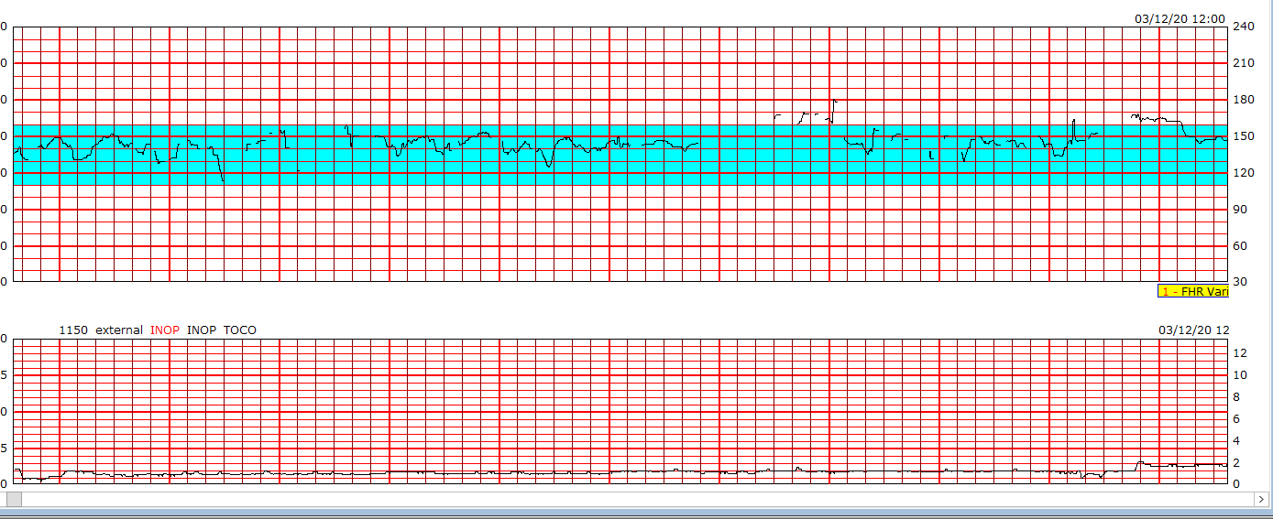
O.C.
Ultrasound/Fetal assessment
TVS: cervix 5 cm long
BPP 10/10, posterior placenta, vertex, normal AFV
NST 145 BPM, moderate variability, accels, no decels
Toco: no ctxs
Labs
CBC: 4.94>12.7/36.1<91 AST and ALT elevated (110, 82 u/L
Respiratory virus panel negative, Urinalysis negative

Slide 41


O.C.
12:45
16:25
17:35
17:52
19:30
Consulted with DOH regarding COVID-19 testing →→advised that COVID-19 testing not indicated
VS: Temp: 38.4 C BP: 102/56 HR: 86 O2 sat: 94% RA
Plan: Admit for suspected pyelonephritis, r/o pneumonia
- Chest X-ray
- Ceftriaxone 1gm IVPB q24 hours
- Droplet precautions
Discussed patient's history and symptoms with DOH
-As per DOH recommendations, COVID-19 testing not indicated
If chest X-ray is +pneumonia, will test for COVID-19
Ceftriaxone started
Chest X-ray done > prelim read negative

Slide 42
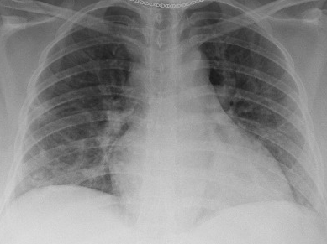
O.C.
3/13/20
11:49:
    CXR: Right mid to lower lung ill-defined opacities, suspect pneumonia.
    →Swab sent for COVID 19 > airborne and contact isolation initiated
13:21:
    Azithromycin 500 mg IVPB added to antibiotic regimen

Slide 43
O.C.
3/14/20
04:00:
    Pt reported difficulty breathing
    Tmax 38.0 C, Room air O2 sat 88-90%
    Supplemental Oxygen administered
    Continuous Fetal Monitoring
    Repeat CXR obtained
    ICU consult requested
    Antenatal corticosteroids initiated
    Cesarean section STAT pack at bedside
13:01:
    Transferred to MICU
    Blood and urine cultures negative , urine Legionella negative

Slide 44

O.C.
3/15/20
12:00:
    COVID-19 resulted positive
    Family members notified
    O2 nasal cannula increased to 6 Liters
    Hydroxychloroquine 200mg PO BID started
    ID consult requested
    T cell subsets: CD4, CD8, CD3
3/19/20
20:20:
    Monitored in the ICU for 5 days with goal to maintain O2 sat ≥ 95%
    Required 6L nasal cannula and intermittent use of non-rebreather mask
    Never required intubation
    Transferred from ICU to dedicated COVID-19 unit
    Fetal status remained reassuring, no contractions
3/20/20
TBD
    Discharged to home quarantine with follow up prenatal appt in 3 weeks

Slide 45
Ambulatory & Inpatient Considerations & Challenges
Michael Nimaroff, MD
Senior Vice President OBGYN Service Line
Adriann Combs, DNP, NNP
Clinical Director OBGYN Service Line
Northwell Health OBGYN Service Line

Slide 46
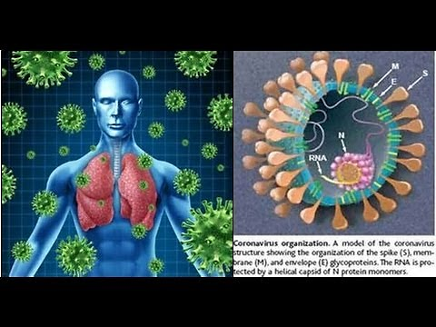
Coronavirus
A cause of the Common Cold, seen frequently on a Respiratory Viral Panel (RVP) used by laboratories
Other Novel Coronaviruses:
    Severe Acute Respiratory Syndrome (SARS) identified in 2003: Caused a self limited outbreak that was associated with a 10% mortality 15 years ago and has disappeared
    Middle East Respiratory Syndrome (MERS) identified in 2012: A respiratory illness with 20% mortality mostly limited to the Middle East that passed form camels to humans
    COVID-19: Identified in China in late December 2019 (likely passed from a bat or other animal to human)
M
S
E
N
RNA
A model of the coronavirus structure showing the organization of the spike (S) Membrane (M) and envelope (E) gtycoproteins
The RNA is protected by a helical capsid of N protein monomers
2

Slide 47
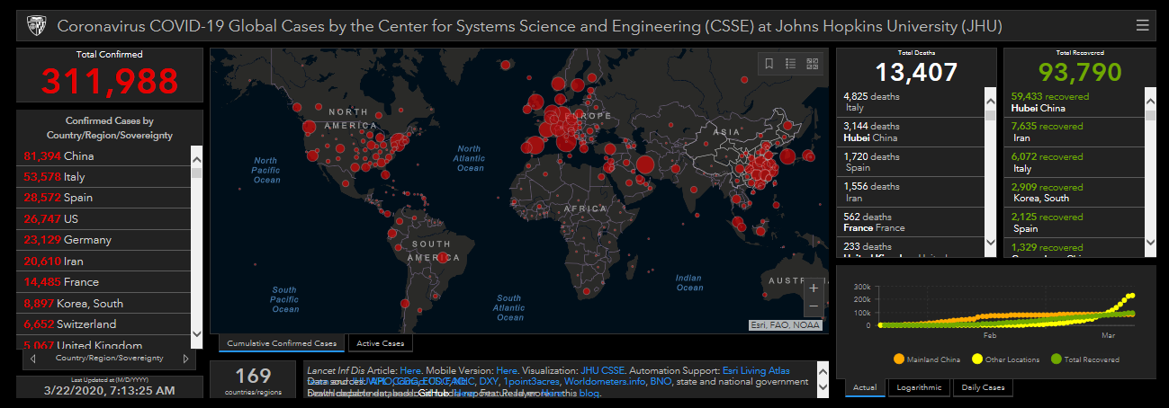
Worldwide BioDashboard (3/22/2020)

Slide 48
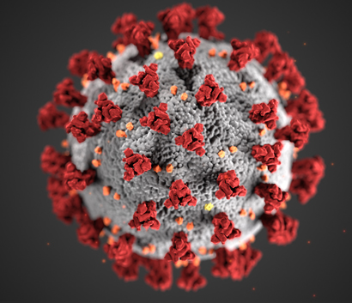
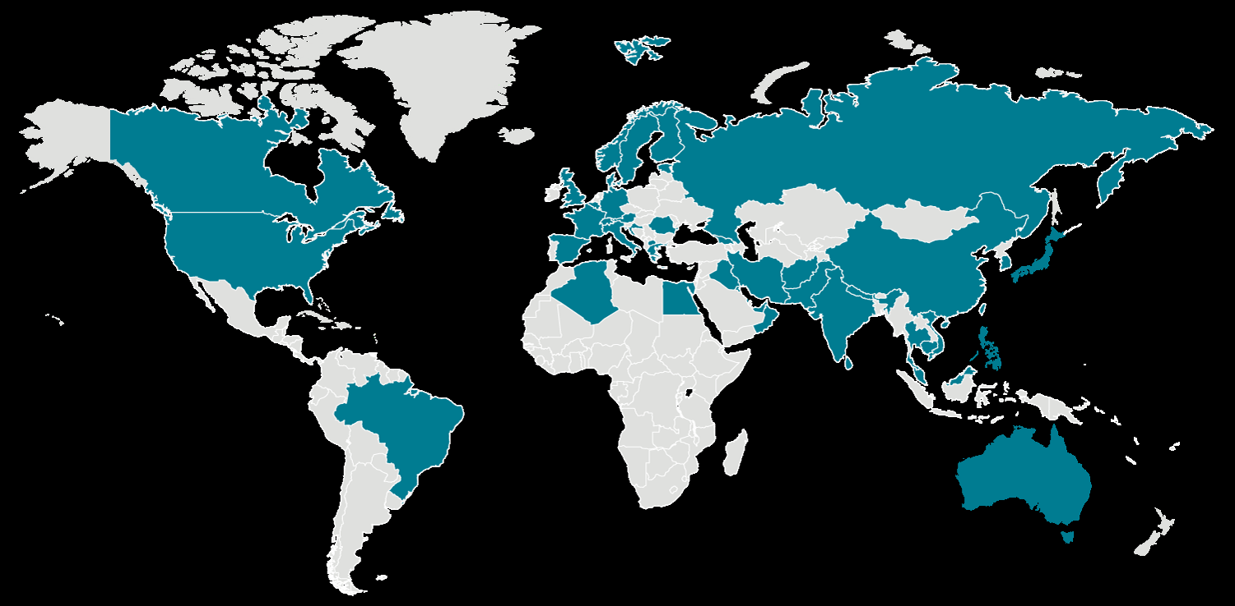
COVID-19 U.S. Cases
The outbreak first started in Wuhan, China, but cases have been identified in a growing number of other international locations, including the United States.
The Centers for Disease Control and Prevention (CDC) has confirmed an infection with the virus that causes COVID-19 in all 50 states
As of March 22:
Cases in United States –23480
Cases in New York – 10356
Cases in NYC – 9,045
Cases in Nassau – 1,900
Cases in Suffolk – 1,034
Cases In Westchester – 1,873
As of 3/22:
NYC 9045 +2834
Nassau 1900 +666
Suffolk 1034 +372
Westchester 1873 +488
5

Slide 49

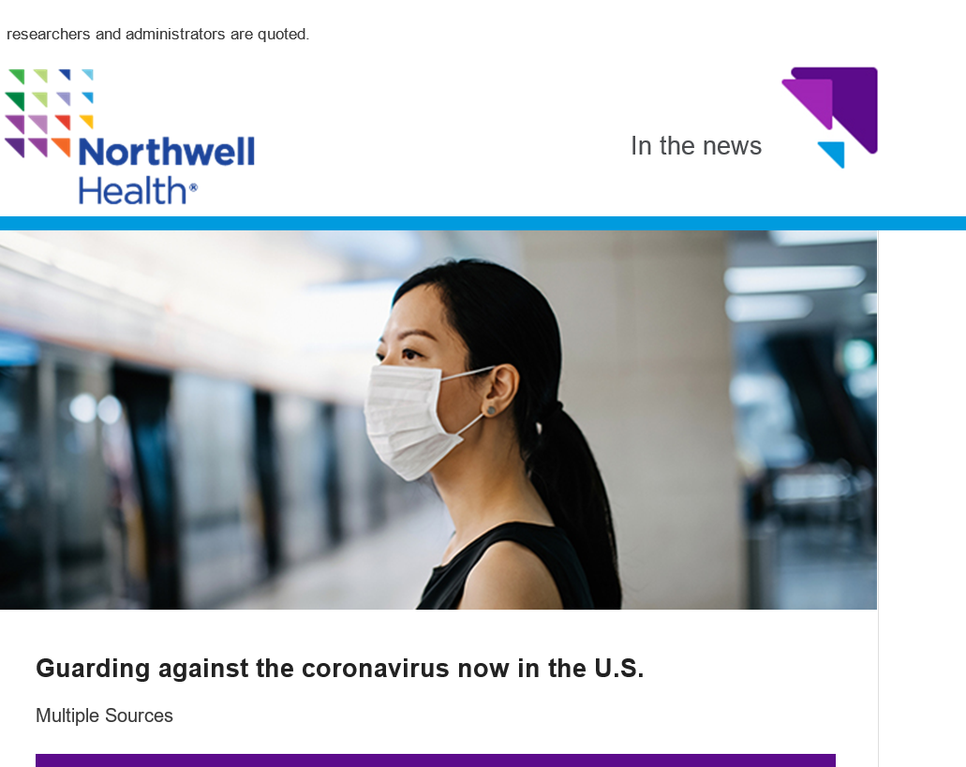


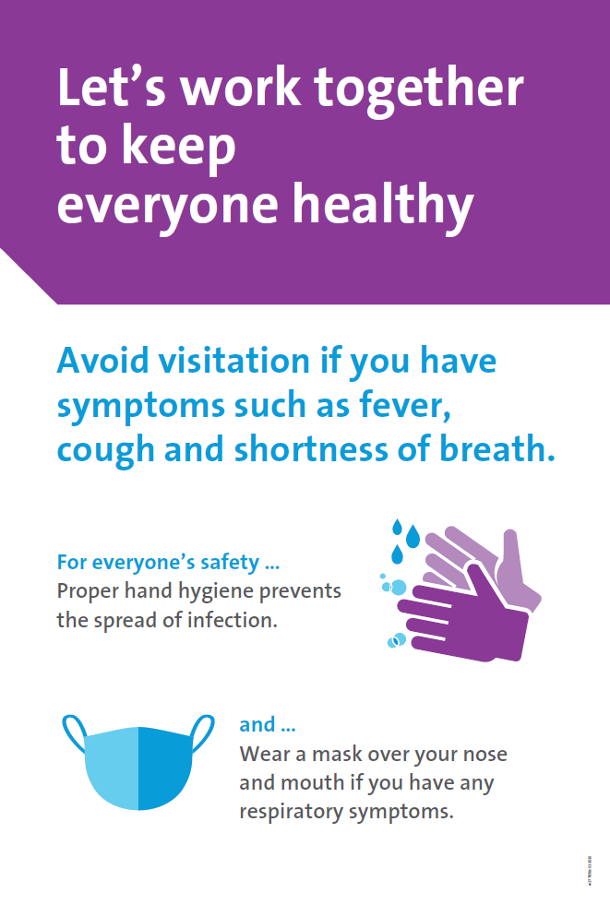




Northwell Health Preparedness
Our Northwell Emergency Management Intranet page is continuously updated with the latest resources related to COVID-19.
Continuous Communication with All Staff
COVID-19 Messages to All Employees are maintained by Clinical Executive Leadership to keep staff engaged with the latest information and system efforts.
COVID-19 Toolkit
Features the latest guidelines, protocols, recommendations and information.
Policies
INF 1144: Personal Protective Equipment (PPE) Donning & Doffing
INF 2006: Respiratory Viruses (Avian Influenza A Viruses, Middle East Respiratory Syndrome Coronavirus, and Other Emerging Viruses Management)
Employee Health Services Guidelines
Monitoring and management of employees returning from travel in affected areas.
Signage
Travel Advisory (Available in multiple languages).
Cover Your Cough (Available in multiple languages).
General Health Advisory
12

Slide 50

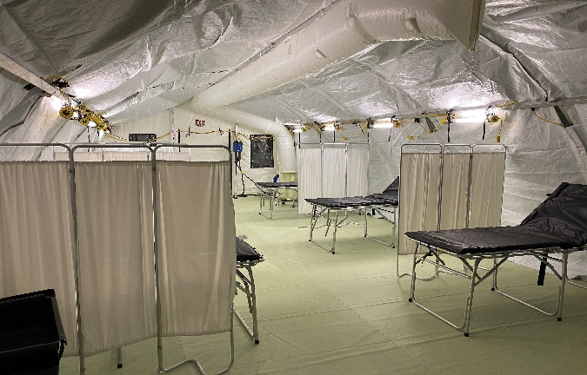



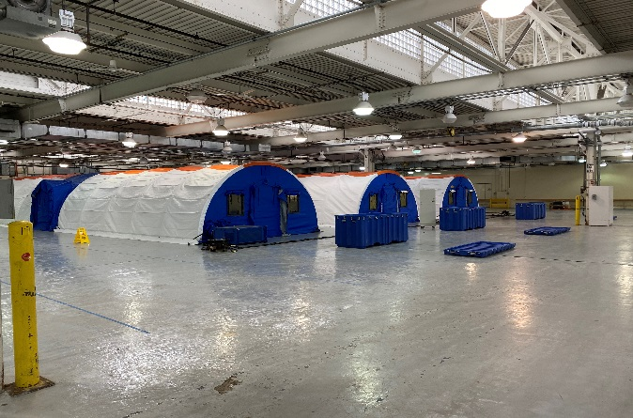

Northwell Health Preparedness Continuous Actions
Currently, the system EOC has been activated to manage the novel coronavirus response and is
resting at a HICS Level 2.
Routine Briefings
To review the latest information, developments and CDC guidelines.
Routine audits to assess compliance with identification, isolation and notification of Persons Under Investigation (PUI).
Lab Specimen Collection Process Flows
Patient Safety Rounds Materials
Education and Q&A Documents related to COVID-19.
Pre-screening Questions for Hospital, Non Hospital, and Ambulatory Locations
Actively used in system EMRs.
Personal Protective Equipment (PPE) Recommendations
Monitoring and management of PPE inventory.
Safe Guidelines for N-95 Mask Reuse
8

Slide 51
Northwell Health System Response
Northwell Health Emergency Response Advisory Team
Service Line Chairs/Leadership
Hospital Chairs
Ambulatory Leadership
Maternity
Hospitals
10
33,000 Del
Voluntary
Physicians
394
NWPP
Physicians
196
Nurses
Residents
Midwives
Support
Staff
Family
Medicine
ACPs

Slide 52
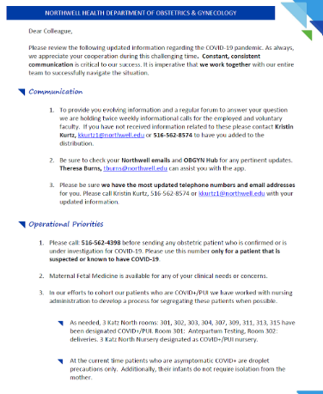
Considerations and Challenges
Educating the Stakeholders
  Staying Current, Consistent and Calm
  Providing Factual Information
  Physicians and Midwives
  Ambulatory and Hospital Staff
  Patients
  Community Partners
Communication & Transparency are Key

Slide 53
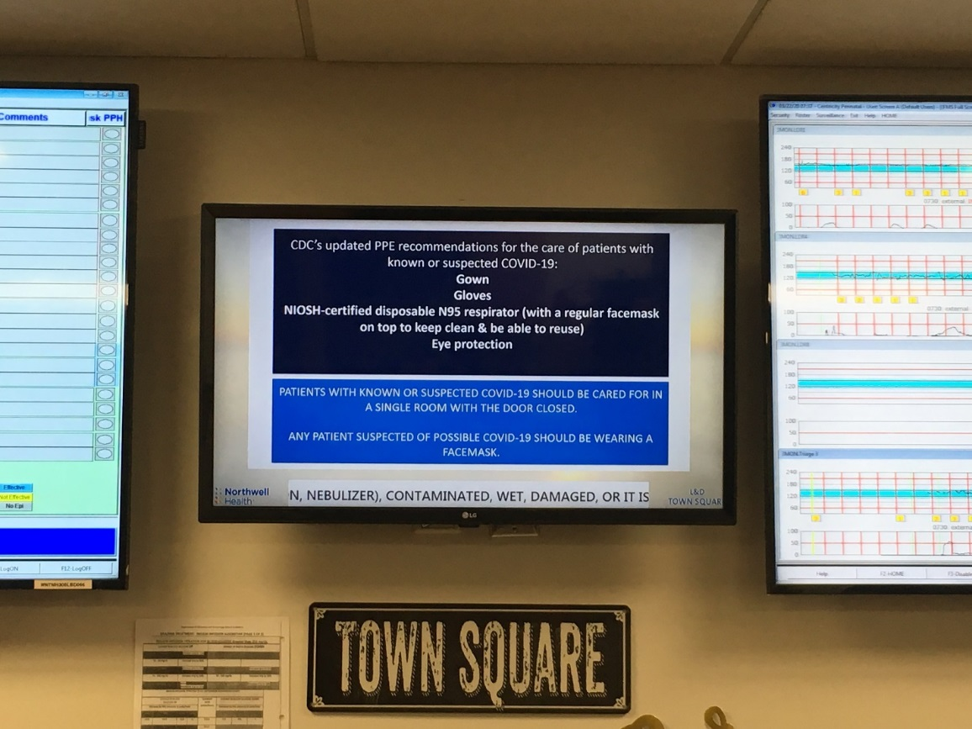
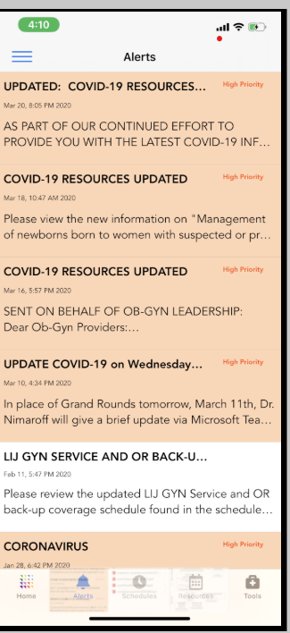
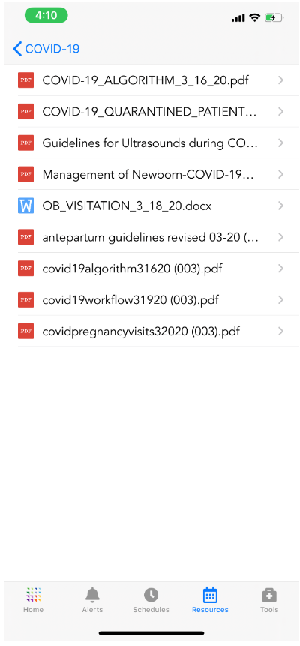
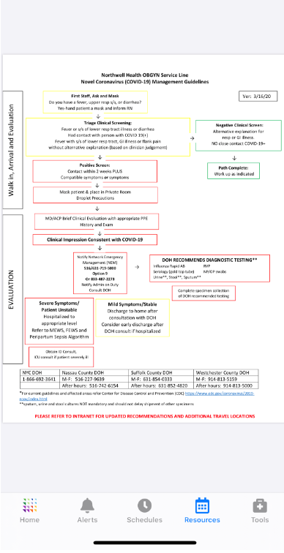
Considerations and Challenges
Communication Platforms
      Daily scheduled calls: Chairs, Leadership
      Twice weekly call with all providers
      Formalized communication structure
      Webinars
      OBGYN Hub-app
      Organized email from a single source to established contacts
      MFM Hotline for providers

Slide 54
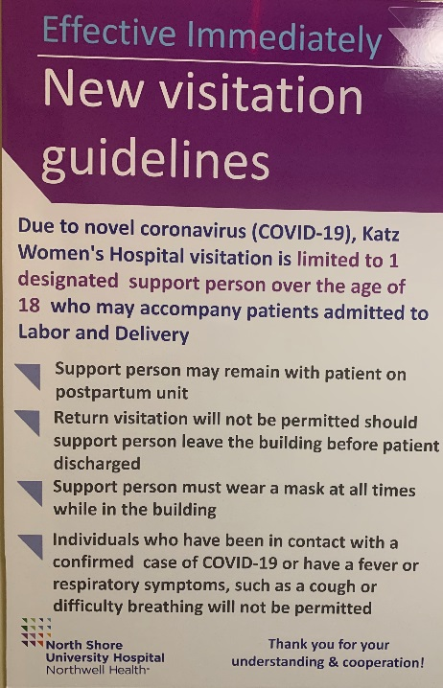
Inpatient Response & Considerations
Establishing appropriate Triage and Treatment Guidelines (changing daily based on prevalence, testing availability, etc)
PPE Guidelines (supply)
OB Management Consideration (MFM)
Management of Critically Ill Patients
Being prepared for deliveries off the unit
Visitation Restrictions
Newborn Management Guidelines
Circumcision Considerations
Ban on Elective Surgery
Attempt to cohort COVID+/PUI Patients
Frequent rounds by leadership

Slide 55
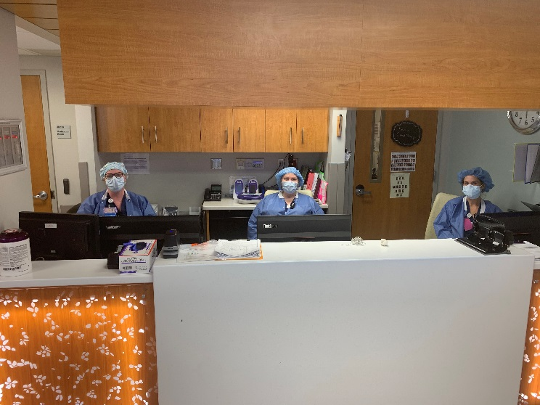
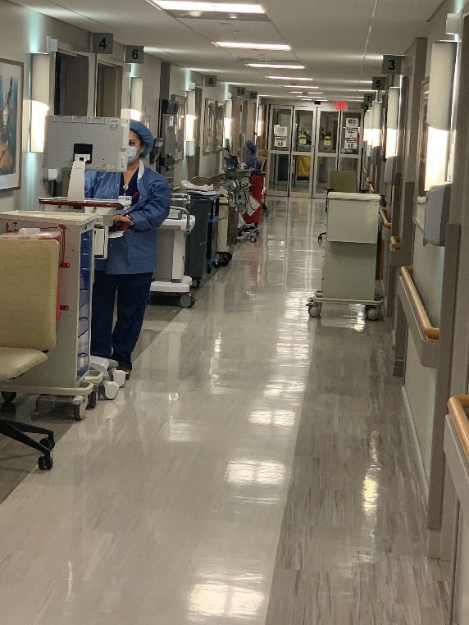
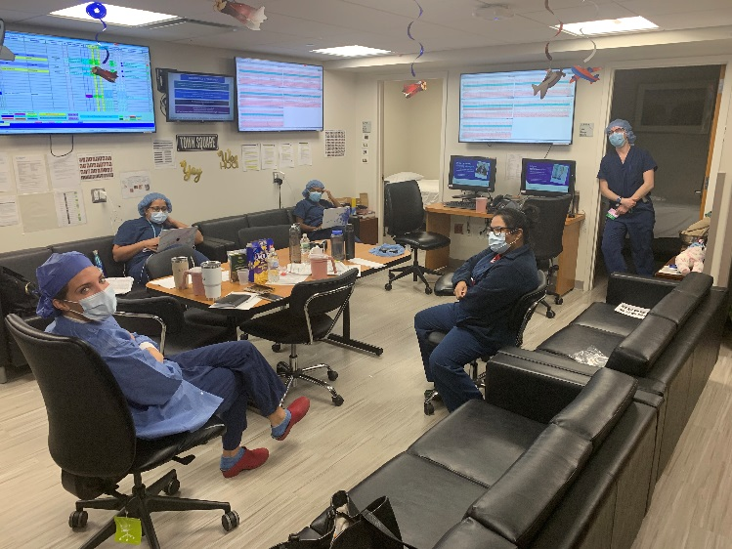
Inpatient Considerations and Challenges
  Institutional leadership needs to understand OB care cannot be curtailed
  (What does the ED, Critical Care and Obstetrics have in common?)
  L&D units and most importantly the staff put themselves at risk everyday

Slide 56
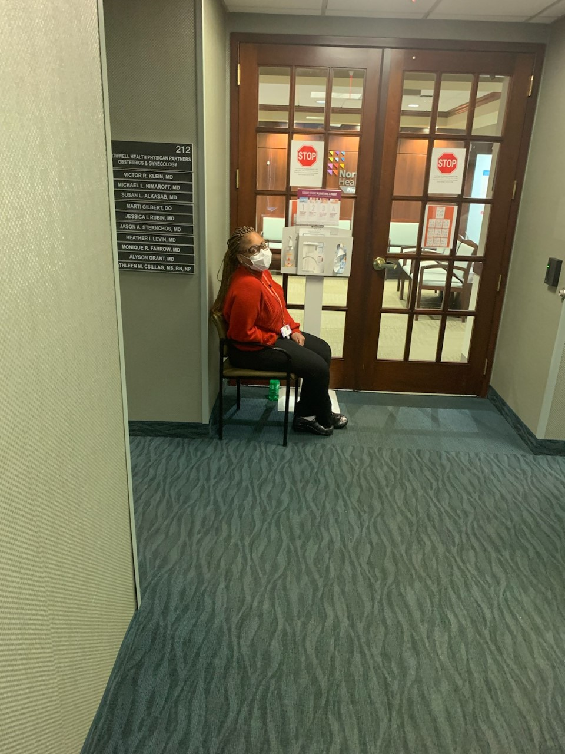
Outpatient Response and Considerations
Establishing appropriate Triage and Treatment Guidelines
Providing PPE Guidance
Decreasing Routine Healthcare Visits
Creative methods to create social distancing
Utilize Telemedicine

Slide 57
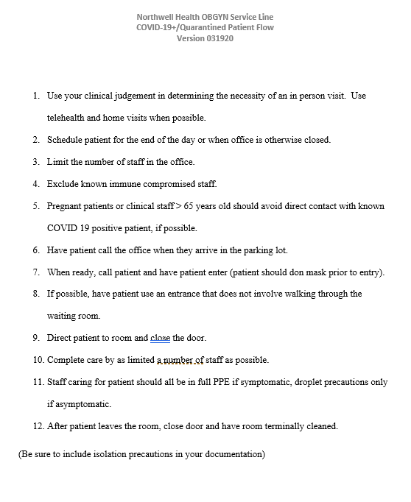
Ambulatory Considerations and Challenges
Home visits
Telehealth
Decreasing Frequency of Prenatal Visits
Creating Regional Ambulatory sites for COVID 19 Sessions
Off hour urgent care to decant ED/L&D Triage for OBGYN complaints

Slide 58
Employee Considerations Guidelines
Testing
Quarantine
Return to Work
Notification: EHS, co-workers, patient contact
Consideration for employees with potential for increased risk (age, pregnancy, comorbidities)
Consistent Messaging

Slide 59

Current Triage Scheme
Mask and ask (patient and visitor)
Asymptomatic droplet precautions
Asymptomatic HR for positive
  Full PPE for labor and delivery
PUI/COVID positive – Full PPE
- When POCDT available, there will be no need for preadmission screening and paradigm will change (hopefully)
- Always mask and ask
New scheme: (Trying to operationalize how to safely perform the tests)
  Test patient 24-36hrs prior to elective delivery before elective scheduled
  Presents in labor without testing/send test and follow above scheme
  Negative test but with new onset symptoms or
  High-risk for positive
  All other negatives normal droplet protection

Slide 60

Next Steps
Prepare for consolidation and possible transfer of OB services to alternative sites and outside of the hospital
Explore same day discharges of normal postpartum patients
Anticipate issues we’ve never faced before!

Slide 61
Next Steps
Prepare for consolidation and possible transfer of OB services to alternative sites and outside of the hospital
Updated triage schemes: Mask/Ask No RF POCDT
Yes Tx as Positive
Coronavirus (COVID-19) Update: FDA Issues first Emergency Use
Authorization for Point of Care Diagnostic Test

Slide 62
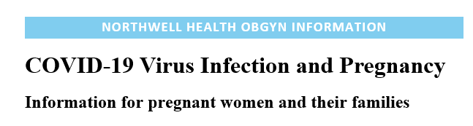
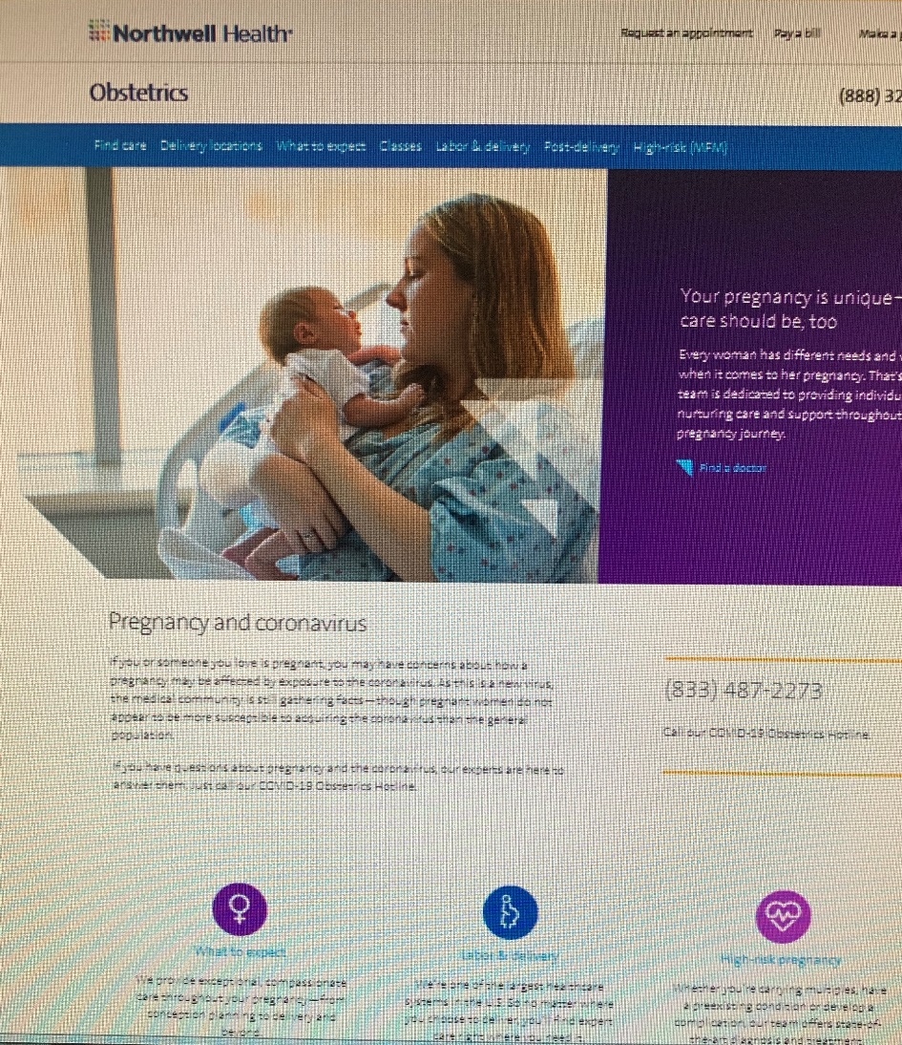
Northwell Health OBGYN
Coronavirus in Pregnancy
Informational Hotline
833-487-2273

Slide 63
Resources
Developed
Clinical Triage Algorithms
Revised Prenatal Visit Schedule
Revised Antepartum Testing Schedule
Revised Prenatal Ultrasound Schedule
COVID+/PUI Workflow
Patient COVID-19 FAQs
Informational Patient Hotline
Physician to MFM Hotline
Telehealth Services
Limited Visitation
OBGYN Hub
In Development
Regional Sites for COVID+/PUIs
Regional Evening/Weekend “walk-in” sites
Home visits

Slide 64
Staff Wellness
“Don’t worry alone.”
Northwell Health OBGYN Service Line

Slide 65
“We must rediscover the concreteness of little things, small gestures of attention we can offer those close to us, our family and friends. We must understand that in small things lies our treasure.
These gestures of tenderness, affection, compassion, are minimal and tend to be lost in the anonymity of everyday life, but they are nonetheless decisive, important.”
-Pope Francis

Slide 66
One Day Closer!!
(to the End
Of Covid)
Dr. Beth Karlan
Northwell Health OBGYN Service Line

Slide 67
References
Novel corona virus disease (COVID-19) in pregnancy; what clinical recommendations to follow? Liang and Acharya
    Acta Obstet Gynecol Scand. 2020;00:1–4
Coronavirus Disease 2019 (COVID-19) and Pregnancy: What obstetricians need to know. Rasmussen, Smulian, et al
    AJOG-March, 2020
Clinical characteristics of pregnancy with the 2019 novel coronavirus disease(COVID-19) infection. Lei D, Wang C et al.
  Chin J Perinat Med 2020; 23 (3).
Novel coronavirus infection and pregnancy. Yang H, Wang C et al.
  Ultrasound Obstet Gynecol 2020

Slide 68
References
Coronavirus disease 2019 (COVID-19) during pregnancy: a case series
  Liu, Weiyong, et al. J of Infection 2020.
Pregnancy and perinatal outcomes of women with COVID-19 pneumona: a preliminary analysis
  Yang, Lian, et al. The Lancet 2020
Epidemiological characteristics of 2143 pediatric patients with 2019 coronavirus disease in China
  Dong, Yuanyuan, et al. Pediatrics 2020.
Clinical analysis of 10 neonates born to mothers with 2019-nCoV pneumonia
  Zhu, H. et al. Transl Pediatr 2020.

Slide 69
Coronavirus in Pregnancy Websites
https://www.cdc.gov/coronavirus/2019-ncov/specific-groups/pregnancy-faq.html
https://www.acog.org/Clinical-Guidance-and-Publications/Practice-Advisories/Practice-Advisory-Novel-Coronavirus2019

Slide 70
ACOG Resources
Christa Christakis
Executive Director, ACOG District II

Slide 71
ACOG COVID-19 Resources
Christa Christakis
Executive Director, ACOG District II

Slide 72

ACOG COVID-19 Resources
Visit:
https://www.acog.org/topics/covid-19
For updates on clinical guidance (practice advisory, elective surgeries), telehealth & more

Slide 73
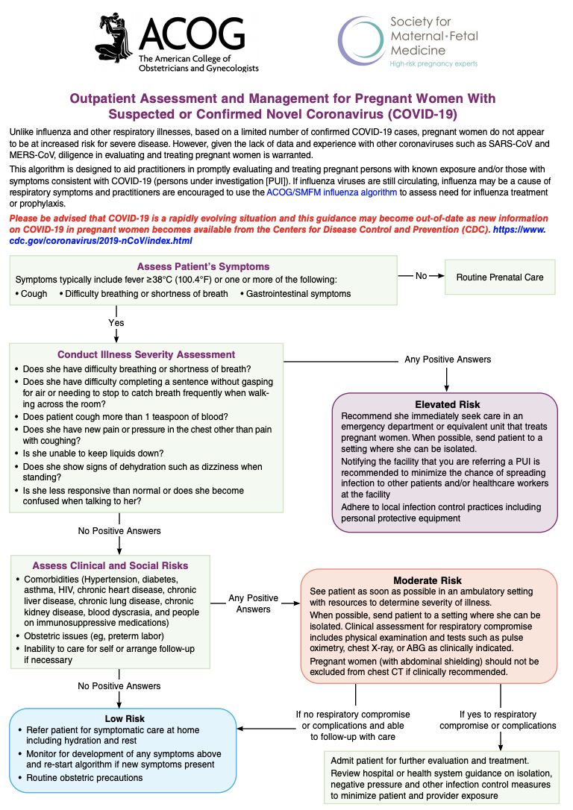
ACOG & SMFM Algorithm
Outpatient Assessment & Management for Pregnant Women with Suspected or Confirmed COVID-19

Slide 74
Connect with ACOG
Email covid@acog.org with questions, or to suggest ways we can support you
Participate in ACOG Engage to connect and ask questions of colleagues across the state
Contact ACOG District II: Christa Christakis, cchristakis@ny.acog.org

Slide 75
Updates from NYS DOH
Clinical Guidance
Marilyn Kacica MD, MPH
Lauren J. Tobias MPP

Slide 76
NYSDOH Guidance: COVID-19
Information for Healthcare Providers
  https://coronavirus.health.ny.gov/information-healthcare-providers
COVID-19 Frequently Asked Questions
  https://coronavirus.health.ny.gov/system/files/documents/2020/03/faqscovid19_32120doh.pdf
Pregnancy and COVID-19: Resources for Healthcare Providers
  https://coronavirus.health.ny.gov/system/files/documents/2020/03/covid-19pregnancyguidanceforproviders3.21.20.pdf
Visitation in the Obstetrical and Pediatric Settings (Updated)
  https://coronavirus.health.ny.gov/updated-guidance-regarding-obstetrical-and-pediatric-settings

Slide 77
Telehealth Guidance
NYSDOH
Jeanne Alicandro MD, MPH
GNYHA Resources
Puja Khare Esq GNYHA

Slide 78
COVID-19 Telehealth and Medicaid Telephonic Communication Services
GNYHA COVID-19 Grand Rounds Webinar:
Special Considerations for the Perinatal Patient
March 23, 2020

Slide 79
Encouraging Use of Telehealth Services
During COVID-19 National Emergency
Effective immediately, Office for Civil Rights (OCR) at the Department of Health and Human Services (HHS) will not impose penalties for noncompliance with the regulatory requirements under the HIPAA Rules against covered health care providers in connection with the good faith provision of telehealth during the COVID-19 nationwide public health emergency.
A covered health care provider that wants to use audio or video communication technology to provide telehealth to patients during the COVID-19 nationwide public health emergency can use any non-public facing remote communication product that is available to communicate with patients.
  Acceptable (non-public facing): Apple FaceTime, Facebook Messenger video chat, Google Hangouts video, or Skype
  Unacceptable (public facing): Facebook Live, Twitch, TikTok
https://www.hhs.gov/hipaa/for-professionals/special-topics/emergency-preparedness/notification-enforcement-discretion-telehealth/index.html

Slide 80
COVID-19 Medicaid Telephonic
Communication Services
During the current State of Emergency only, New York State Medicaid will reimburse telephonic evaluation and management services to members who are established patients or the legal guardian of an established patient in cases where face-to-face visits may not be recommended and it is medically appropriate for the member to be evaluated and managed by telephone. Telehealth will be covered for all appropriate services for all patients appropriate to treat through this modality.
Relevant CPT codes are:
“99441”: Telephone evaluation and management service; 5-10 minutes of medical discussion Fee: $12.56
“99442”: 11-20 minutes of medical discussion Fee: $23.48
“99443”: 21-30 minutes of medical discussion Fee: $37.41

Slide 81
COVID-19 Telehealth Services
To the extent it is practical, the Department encourages the use of telehealth to provide COVID-19 related services.
The NYS Telehealth Parity Law requires commercial insurers (under the jurisdiction of the Division of Financial Services) and the Medicaid program (administered by the Department of Health) to provide reimbursement for services delivered via telehealth, if those services would have been covered if delivered in person.

Slide 82
GNYHA Resources: Telehealth
Puja Khare, GNYHA

Slide 83
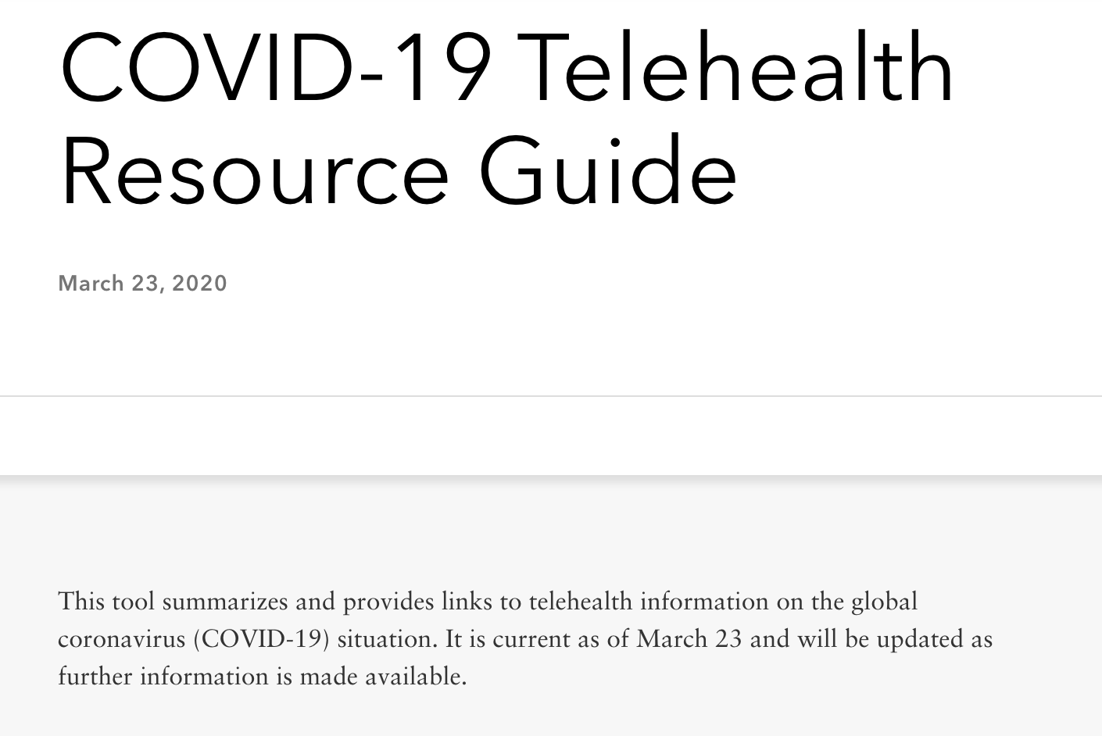
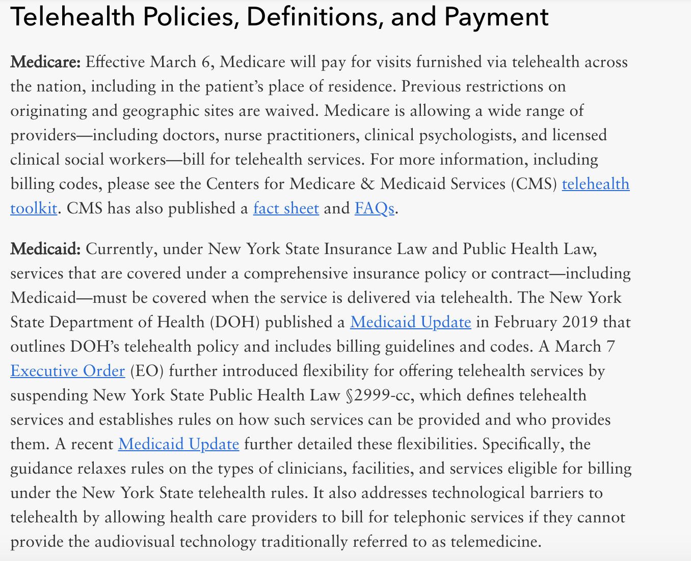
GNYHA Telehealth Resources
Telehealth Resources: General
  Summary of :
    Licensing requirements
    Privacy and security considerations
    Payment
Telehealth Billing
  Medicare services covered
  Codes
Telehealth Licensure
  Summary of licensure requirements for NYS and surrounding states including NJ, PA, CT etc.
Access resources from: https://www.gnyha.org/tool/covid-19-telehealth-resource-guide/

Slide 84
Q&A
Organizations Represented:
NYSDOH
ACOG District II & local OBGYN leaders
Association for Licensed Midwives

Slide 85
Contact Information: Northwell Team
Adriann Combs, DNP, NNP-BC
Clinical Director Service Line
Obstetrics and Gynecology
acombs@northwell.edu

Slide 86
Contact Information: ACOG
Christa Christakis
Executive Director
ACOG District II
cchristakis@ny.acog.org

Slide 87
Contact Information: NYSDOH
NYSDOH Team
NYSPQC@health.ny.gov

Slide 88
Contact Information: GNYHA
Lorraine Ryan
Senior Vice President
Legal, Regulatory and Professional Affairs
212-506-5416
ryan@gnyha.org
Puja Khare
Assistant Vice President
Legal, Regulatory, and Professional Affairs
212-506-5535
pkhare@gnyha.org
Wing Lee
Director
Quality, Patient Safety & Clinical Programming
212-554-7208
Wlee@gnyha.org

