Slide 1
Patient Evacuation Toolkit Implementation Webinar
Thursday, June 22, 2017

Slide 2
Today’s Speakers
Genesis and Overview of the Patient Evacuation Toolkit
Jenna Mandel-Ricci, Vice President, Professional and Regulatory Affairs, GNYHA & Tim Styles, Medical Director, Bureau of Healthcare System Readiness, NYC Department of Health and Mental Hygiene
Using Toolkit Tools to Advance Hospital and Health System Readiness
Craig Simpkins, Regional Director, Occupational and Environmental Safety, and Colleen Lyons, Chief Information Officer, Lenox Hill Hospital
Kevin Chason, Clinical Director, Emergency Management, The Mount Sinai Health System

Slide 3
Post-Sandy: Efforts to Address System Gaps
Overall Efforts
Efforts Specific to Healthcare
Introduction of new evacuation zone framework
Six rather than three zones; take into account storm bearing, surge, and still water flooding
Revisions to coastal storm plans
Development/launch of eFINDS patient tracking system
Significant improvements made to the Healthcare Evacuation Center; application development and testing
Focus on decision making process and timeline for healthcare evacuation
Extensive analysis of healthcare facility receiving capacity

Slide 4
Additional Issues That Make Large-Scale Patient Evacuation Challenging
Finding appropriate beds for certain patients was particularly challenging during Hurricane Sandy
Concerns about continuity of care for very sick patients during evacuations that can take several hours
Recognition that subject matter experts in hospitals were best positioned to address these issues
The Patient Movement Workgroup is born!

Slide 5
Patient Movement Workgroup: Initial Development
Co-led by NYC Department of Health and Mental Hygiene and GNYHA
Created initial workgroup agenda based on conversations with key staff at hospitals most impacted by Hurricane Sandy
Assembled representatives from a broad range of hospitals – large health systems as well as stand-alone hospitals + representatives from government agencies involved in evacuation planning and response
Monthly, in-person meetings with conference line option; met from early 2015 through 2016
After each meeting, detailed notes were sent to entire group, and work was done to advance documents and processes between meetings

Slide 6
Patient Movement Workgroup: Scope of Projects
Began by developing standardized bed definitions to facilitate bed matching at a regional level
From work on this issue, a number of other challenges emerged that the group sought to address, including:
Facilitating sharing of critical medical information during transport
Increasing post-transfer PHI exchange between sending and receiving facilities
Best practices related to emergency credentialing of healthcare personnel (will not touch on this during today’s presentation)
Initial workgroup members included emergency managers and clinical leaders; pulled in other subject matter experts as necessitated by our work
These included transfer center staff, heath IT experts, and medical staff specialists

Slide 7
1. Standardized Bed Definitions to Facilitate Bed Matching: Concern and Goal
Concern
Goal
During Hurricanes Sandy and Irene, different understandings of commonly used bed type terms compromised the ability of involved staff to identify appropriate beds/resources for patients that needed to be evacuated.
Put another way, an ICU bed is not an ICU bed is not an ICU bed across different types of institutions.
Create standardized bed definitions that can be used as a common vocabulary regionally or statewide to facilitate appropriate bed matching.

Slide 8
Standardized Bed Definitions to Facilitate Bed Matching: Initial Approach Using Existing Classifications
NYS Licensed Bed Types (36 Total) |  |  | NYS Healthcare Evacuation Center Categories (18 total) | VA/DoD Categories (7 total)
Medical/Surgical Intensive Care Coronary Care Pediatric Maternity Respiratory Physical Medicine and Rehabilitation Psychiatric Burns Care Pediatric ICU Traumatic Brain Injury Chemical Dependence – Detoxification Chemical Dependence – Rehabilitation | Alcohol Detoxification Prisoner RHCF RHCF- Coma Recovery Inpatient Certified Drug Rehabilitation Special Use Bone Marrow Transplant RHCF Traumatic Brain Injury AIDS-SNF SNF- Head Injury Rehabilitation Medical-Surgical (T.B.) Coma Recovery | Neonatal Continuing Care Neonatal Intensive Care Neonatal Intermediate Care AIDS Ventilator Dependent Behavioral Intervention Transitional Care Residence Behavioral Intervention Step Down Ventilator Dependent Pediatric | Adult med/surge Peds med/surge Adult ICU Peds ICU Adult acute rehab Peds acute rehab TBI acute care Coma recovery Ventilator Bariatric AIIR Room Adult psych Peds psych Infant cribs Healthy newborn isolettes NICU Labor and Delivery Post Delivery | Critical Care Medical and Surgery Psychiatry Burn Pediatric Pediatric Critical Care Negative Pressure / Isolation

Slide 9
Developing Standardized Definitions
Group worked to reduce these categories into the smallest possible number that still allowed for specificity
Developed definitions for 5 broad categories; standard definition for large majority of patients + augmented definition for patients in that category who required specialized resources
Critical Care
(adult/pediatric)
Med/Surg
(adult/pediatric)
Perinatal (antepartum, labor and delivery, postpartum, healthy newborn)
Psychiatric (geriatric, adult, child, adult addiction treatment – medically managed, adult addiction treatment – medically supervised)
Rehab
(adult, pediatric)
Focus on staff and equipment that would be needed for patients in each category.

Slide 10
Operationalizing Use of Standardized Bed Definitions
Once we developed the definitions, we needed to operationalize their use during an evacuation scenario.
We designed forms to facilitate evacuation planning whether the facility is managing the evacuation on its own, via its healthcare system, or using government assistance.
Separate forms for sending vs. receiving hospitals
For sending facilities - basic form to be used at unit level, plus aggregate forms for use in Hospital Command Center
Forms incorporate NYS DOH Transportation Assistance Levels (TALs)

Slide 11
Testing of Standardized Definitions and Forms
Verified standard and augmented definitions with specialists in each area
Conducted three separate pilot tests:
Each pilot focused on distinct bed categories, and involved multiple units
The first two pilots also included QA/QI to ensure validity of definitions
Captured patient names and assigned bed category; post pilot categorization conducted again by clinician using information available from EMR
After each pilot, made significant revisions to forms and developed additional tools
Pre-event unit crosswalk
Transportation Assistance Level Job Aid

Slide 12
Additional Opportunities
Additional Opportunities
Advocating that NYSDOH to adopt these definitions into their Healthcare Evacuation Center application
It is technically possible to build logic into EMR systems to automatically and continuously assign patients to a Standardized bed category and a Transportation Assistance Level; Stanford Children’s Hospital has developed this capability
Such approaches have the potential to improve both day-to-day transfers and large-scale patient evacuations

Slide 13
2. Facilitating Sharing of Critical Medical Information During Transport Process: Concern and Goal
Concern
Goal
During Hurricanes Sandy and Irene, basic clinical and demographic information was not always available to the clinicians and staff responsible for staging at the sending hospital, facilitating transport, and triage, as well as those providing initial care at the receiving hospital – a process that can take several hours.
Facilitate process by which all patients have critical clinical and demographic information with them throughout the transport process.

Slide 14
Facilitating Sharing of Critical Medical Information During Transport Process: Approach
While some jurisdictions have developed a stand-alone patient evacuation form, workgroup members concluded that using day-to-day systems and documents would result in higher adherence during an emergency incident.
Workgroup considered several sources of clinical and demographic information.
After considerable deliberation, we decided use of inter-facility transfer forms and patient face sheets was most sensible.
Generally used at hospitals across the NY Region, and day-to-day purpose mimics the intended purpose during an emergency evacuation.
Workgroup examined nearly a dozen examples of such forms, assessing the frequency with which various elements were used, and weighing the importance of these elements during a large-scale patient evacuation.

Slide 15
Facilitating Sharing of Critical Medical Information During Transport Process: Suggested Data Elements
Based on the frequency analysis, workgroup members collaboratively developed a list of suggested data elements for inter-facility transfer forms and patient face sheets, with four information domains:
Demographic
Patient
Transport-related
Clinical

Slide 16
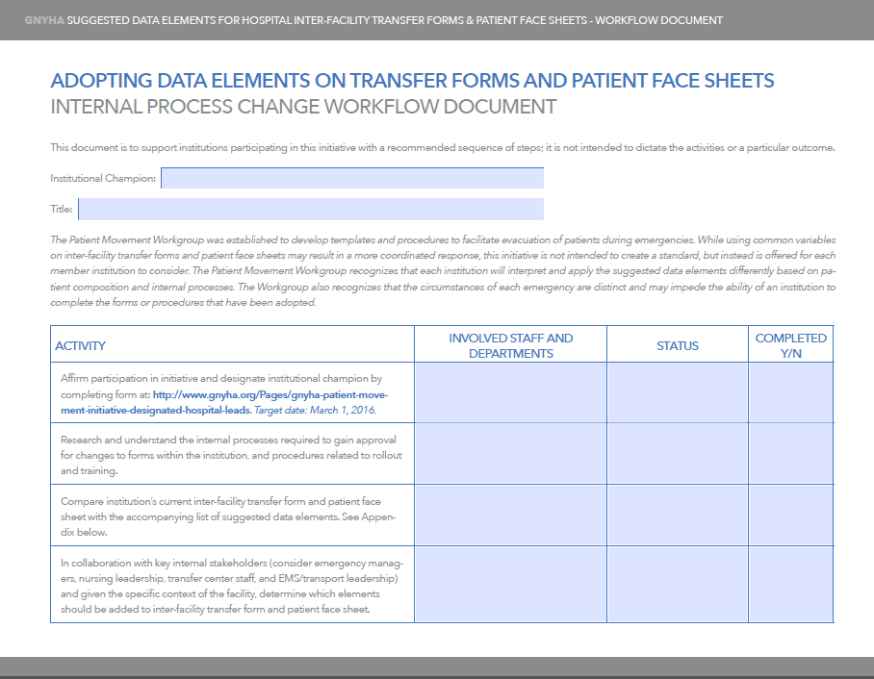
Launch of Transfer Form Initiative, including Suggested Internal Process
Package sent to CEOs of all member hospitals January 2016. Included:
List of suggested data elements
Internal process change workflow document
Ask of facilities:
Compare the list of suggested data elements against internal documents and consider adjustments based on patient population and service lines
Consider how EMR changes could facilitate auto-population of fields
[

Slide 17
Implementation Efforts
Richmond University Medical Center
(Stand alone hospital, Staten Island)
Jamaica Hospital
(Part of small health system in Queens)
Use Meditech EMR
Created two summary documents that pull in majority of suggested data elements
Physician documentation tool
Nursing documentation summary
Component of discharge packet that is used day-to-day; printed with single click from desktop – to15 pages total
Abbreviated version developed for emergency use
Health Informatics, Emergency Management, and Clinical Leadership Staff involved
~40 hours of programming to create forms
Use Epic EMR
Created emergency transfer form that is largely auto-populated from EMR
Includes most of variables from suggested data elements list + 48 hours of progress notes
Use of form triggered by activation of Hospital Command Center; transfer form button becomes active on EMR screen
Staff involved: Nursing, Social Work, Health Informatics, Emergency Management, reps from all clinical disciplines
Notes:
Mention two implementation calls in April and June

Slide 18
3. Increasing Post-patient Transfer Data Exchange between Sending and Receiving Facilities: Concern and Goal
Concern
Goal
Despite advances in HIE and EMR remote access capabilities, clinicians at receiving hospitals often have difficulty accessing key portions of the medical record post-patient transfer.
Facilitate planning discussions between likely send-receive partners to develop record sharing strategies in advance.
Notes:
Area particularly difficult because there is a lot of promise/potential with data sharing but emergency managers need to be focused on what capabilities exist today not what may exist tomorrow

Slide 19
Increasing Post-patient Transfer Data Exchange between Sending and Receiving Facilities: Approach
Very practical approach – any method of data exchange/data sharing is acceptable; emphasis is on pre-planning
Help facilities understand current capabilities related to data exchange:
Summary forms, reports, and documentation used day-to-day by clinicians
EMR platform remote access capabilities
RHIO utilization – mode used and type of data shared
Encourage planning conversations with likely send-receive partner institutions:
Decide in advance HOW data can be most easily shared
Work through needed system modifications and permissions NOW to facilitate exchange at the time of an event
[

Slide 20
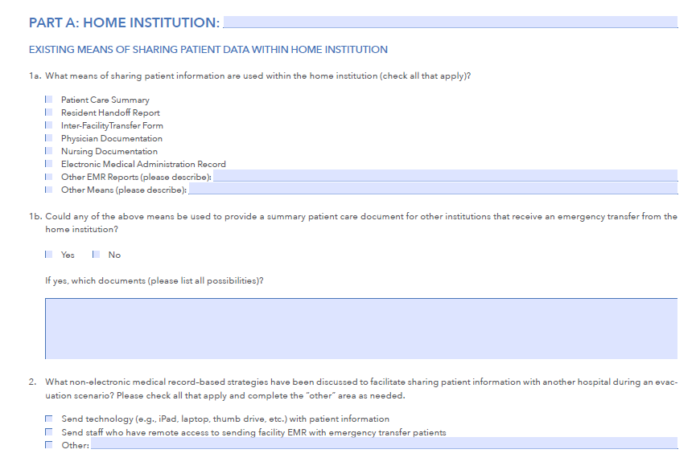
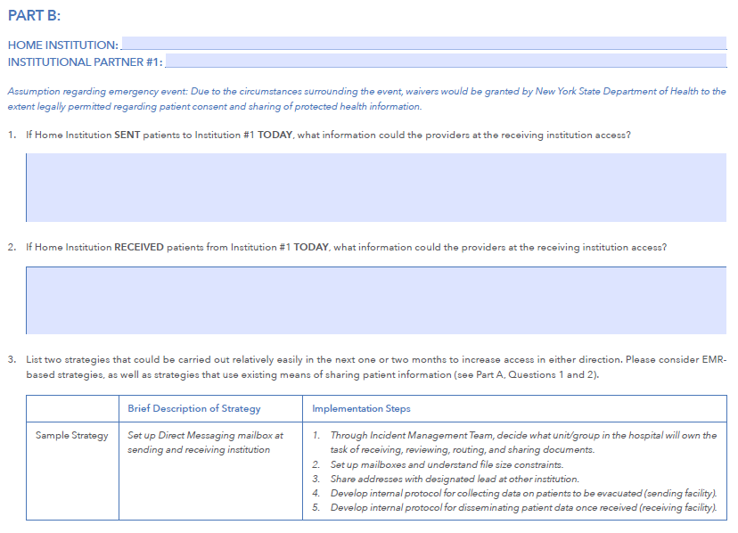
Worksheet Developed and Disseminated
Part A designed to help hospitals better understand their own medical record sharing capabilities
Parts B through D (all identical) designed to facilitate planning conversations between a home institution and 3 partner institutions

Slide 21
Implementation Efforts
Worksheet process works best if multi-disciplinary
Different roles may be needed to complete Part A (for own institution) vs. Part B (data sharing with other institutions)
Users reported the process was eye opening for understanding data-sharing limitations
Facilitates practical conversations with send-receive partners about what data can be shared currently and by what method

Slide 22
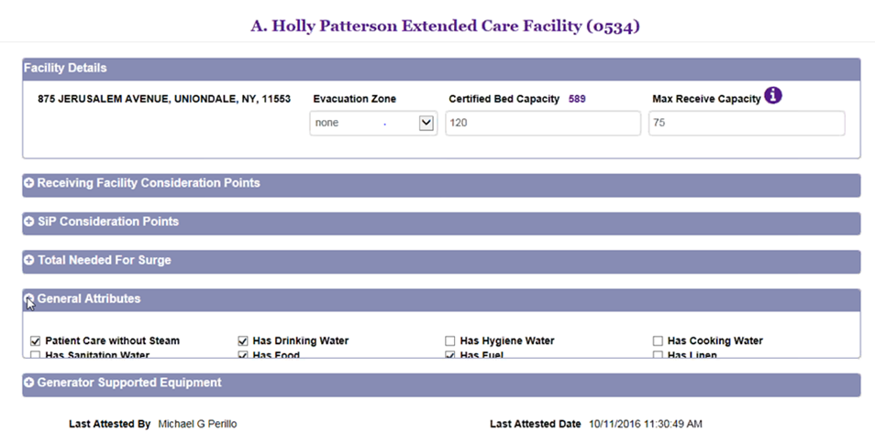
Additional Opportunities
Would like to understand how hospitals on the same EMR platform can best configure their systems to maximize data sharing during an evacuation scenario
Exploring with NYS DOH how information about data sharing capabilities can be integrated into the Facility Profile Application (used to collect critical facility information annually)

Slide 23
Using Toolkit Tools to Advance Hospital and Health System Readiness
Craig Simpkins, Regional Director, Occupational and Environmental Safety, and Colleen Lyons, Chief Information Officer, Lenox Hill Hospital

Slide 24
Lenox Hill Hospital (LHH) Implementation Efforts
Local Efforts
IT Implementation
Multiple staff from LHH involved in the pre-planning stage
Dissemination and adoption phase
Will engage EM committee members to introduce this new initiative
Develop sub-committee of Nursing, Bed Mgmt, IT, Social Work and Admin
Review with EM committee
Incorporate final addition into established plans
Drill to improve process
Will ensure Communication Plan to staff has been completed and agreed upon
Ensure that Toolkit available on EMR “downtime” workstations that have capability to also print to non-networked printers
Look into capability/cost of including as a Tiered application in Downtime/Disaster recovery efforts which would include offsite access to the Toolkit
Notes:
Mention two implementation calls in April and June

Slide 25
Using Toolkit Tools to Advance Hospital and Health System Readiness
Kevin Chason, Clinical Director, Emergency Management, The Mount Sinai Health System

Slide 26
Health System Strategy
Newly merged health system
7 hospitals
3 EMRs
3 bed management systems
4 ADT systems
Centralized Transfer Service

Slide 27
Hospital based activity
IT/ Emergency Management Subcommittee
Initial charge to manage potential loss of technology
Scope increased to include joint IT-emergency management and Health Information Sharing
Emergency Managers socialized tools with key stakeholders
EMR/Informatics
Bed Management
Transfer Service

Slide 28
Hospital Planning
Electronic and Paper solutions
EMR reports
System hospitals transitioning to EPIC
Forms to gather and report data

Slide 29
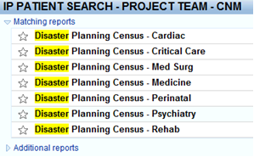
EMR solutions
Reports

Slide 30
EMR Solutions

Slide 31
Paper Solutions

Slide 32
Paper Solutions

Slide 33
Paper Solutions

Slide 34
Thank you to all our presenters and participants!
Jenna Mandel-Ricci
Vice President, Regulatory and Professional Affairs, Greater New York Hospital Association
Phone: 212.258-5314
E-mail: jmandel-ricci@gnyha.org

